Slide 1
How many…?

Slide 2
Demonstration!

Slide 3
How many grapes?

Slide 5
How many grapes?

Slide 6
17 grapes!

Slide 7
Ready?

Slide 8
How many apples?

Slide 9
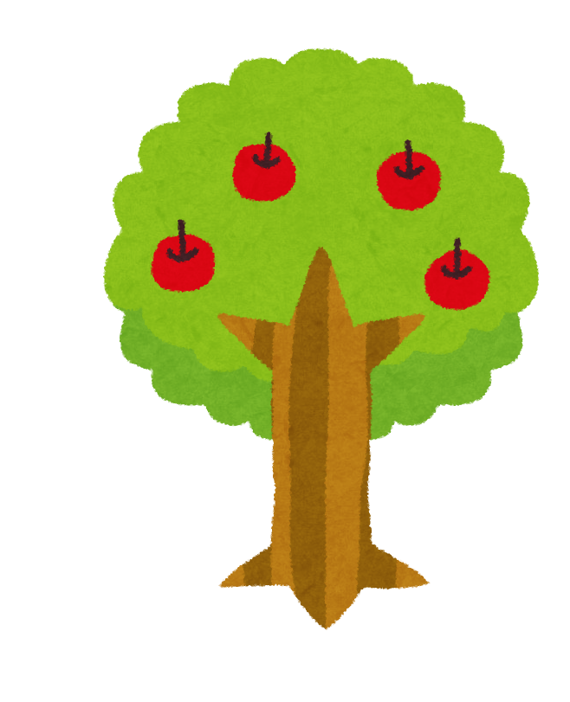
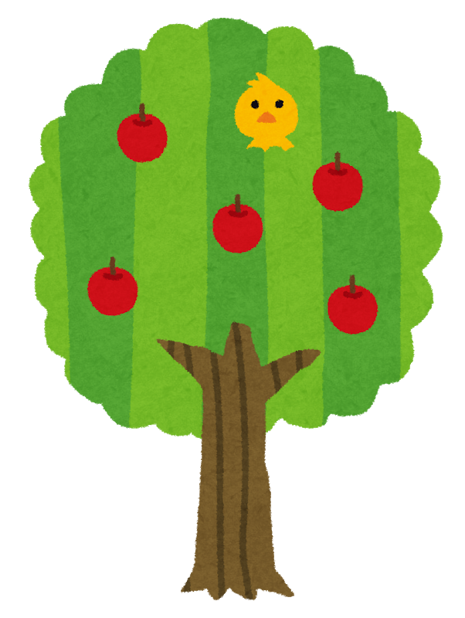
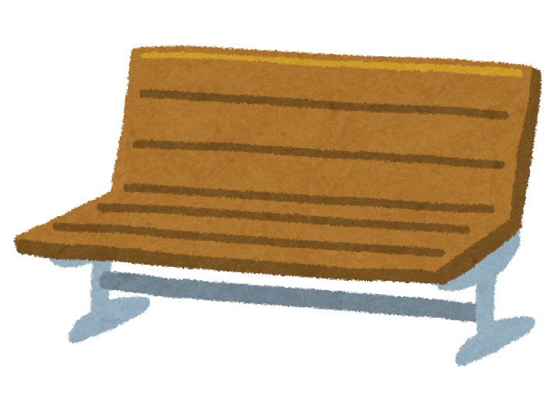

Slide 10
How many apples?

Slide 11
10 apples!

Slide 12
How many oranges?

Slide 14
How many oranges?

Slide 15
7 oranges!

Slide 16
How many bananas?

Slide 17
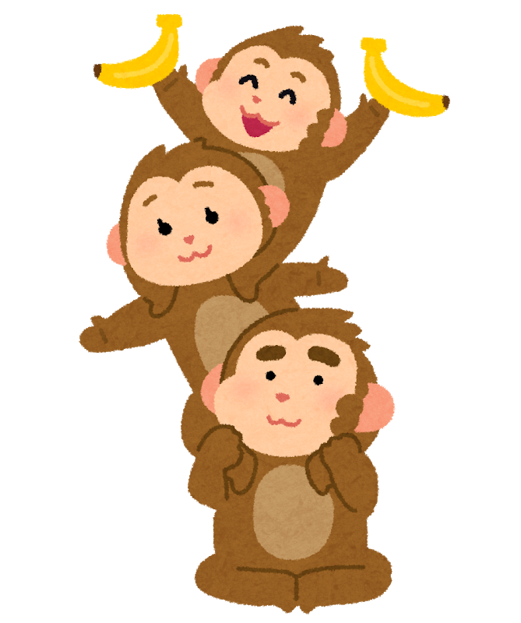

Slide 18
How many bananas?

Slide 19
16 bananas!

Slide 20
How many lemons?

Slide 21
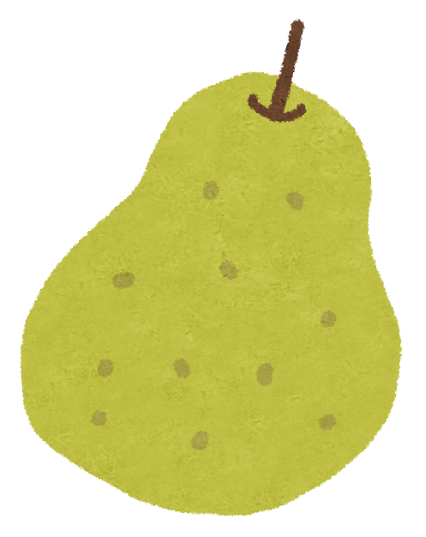

Slide 22
How many lemons?

Slide 23
4 lemons!

Slide 24
How many peaches?

Slide 25
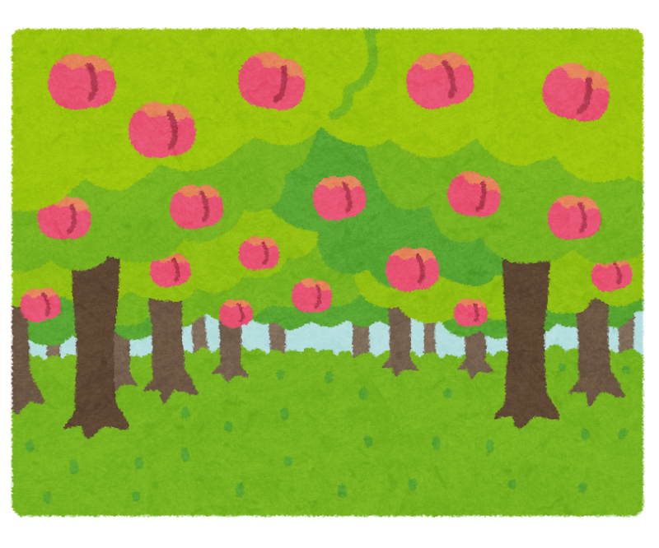

Slide 26
How many peaches?

Slide 27
18 peaches!

Slide 28
How many strawberries?

Slide 30
How many strawberries?

Slide 31
11 strawberries!

Slide 32
How many melons?

Slide 34
How many melons?

Slide 35
6 melons!

Slide 36
How many pears?

Slide 38
How many pears?

Slide 39
13 pears!

