Slide 1
Teacher Quiz!

Slide 2
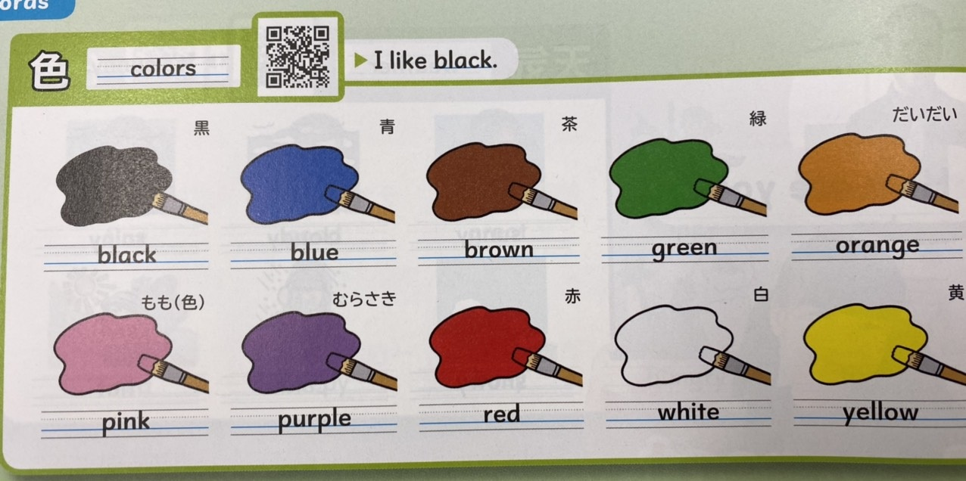
What color do you like?

Slide 3
What color do you like?

Slide 4
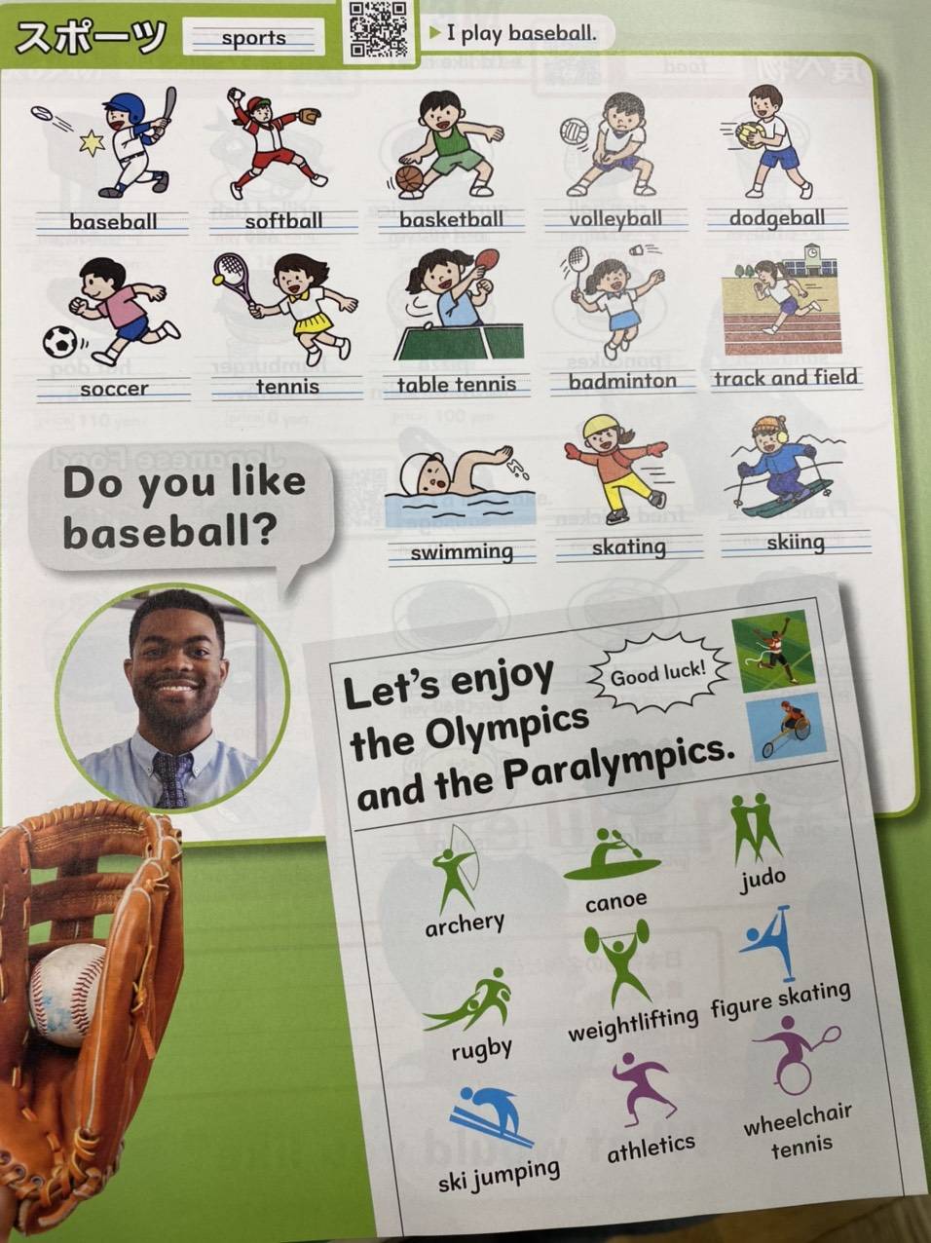
What sport do you like?

Slide 5
What sport do you like?

Slide 6
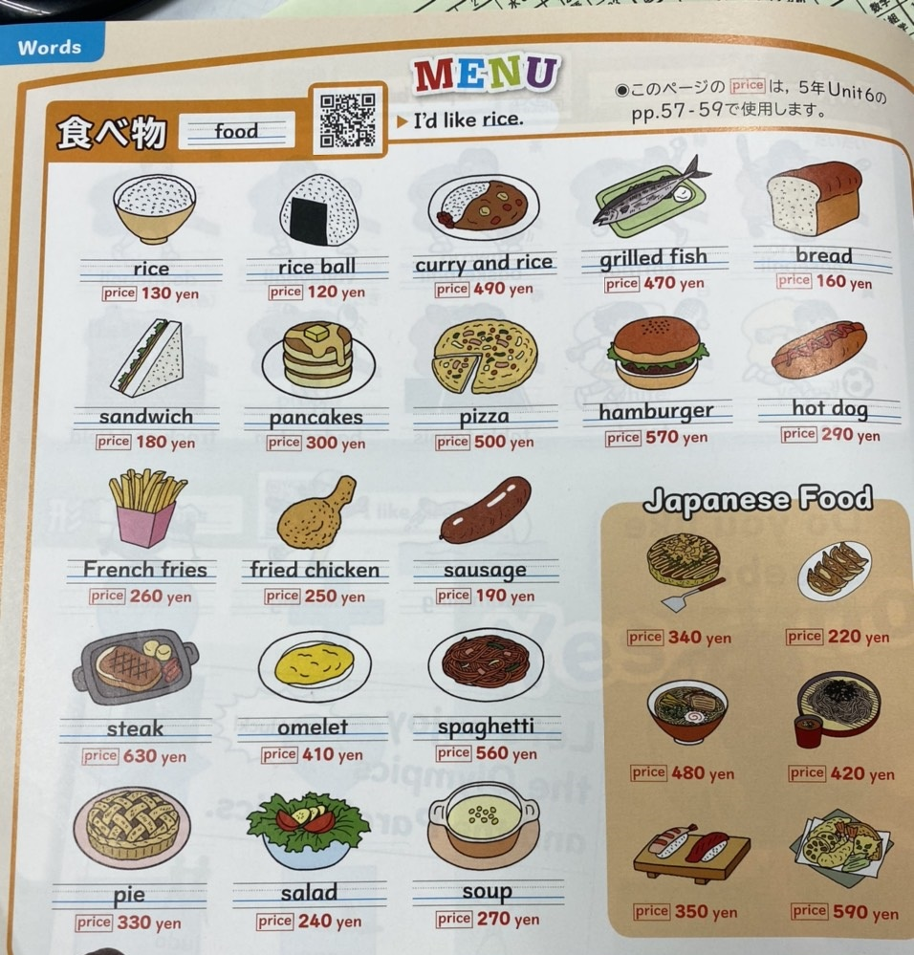
What food do you like?

Slide 7
What food do you like?

Slide 8
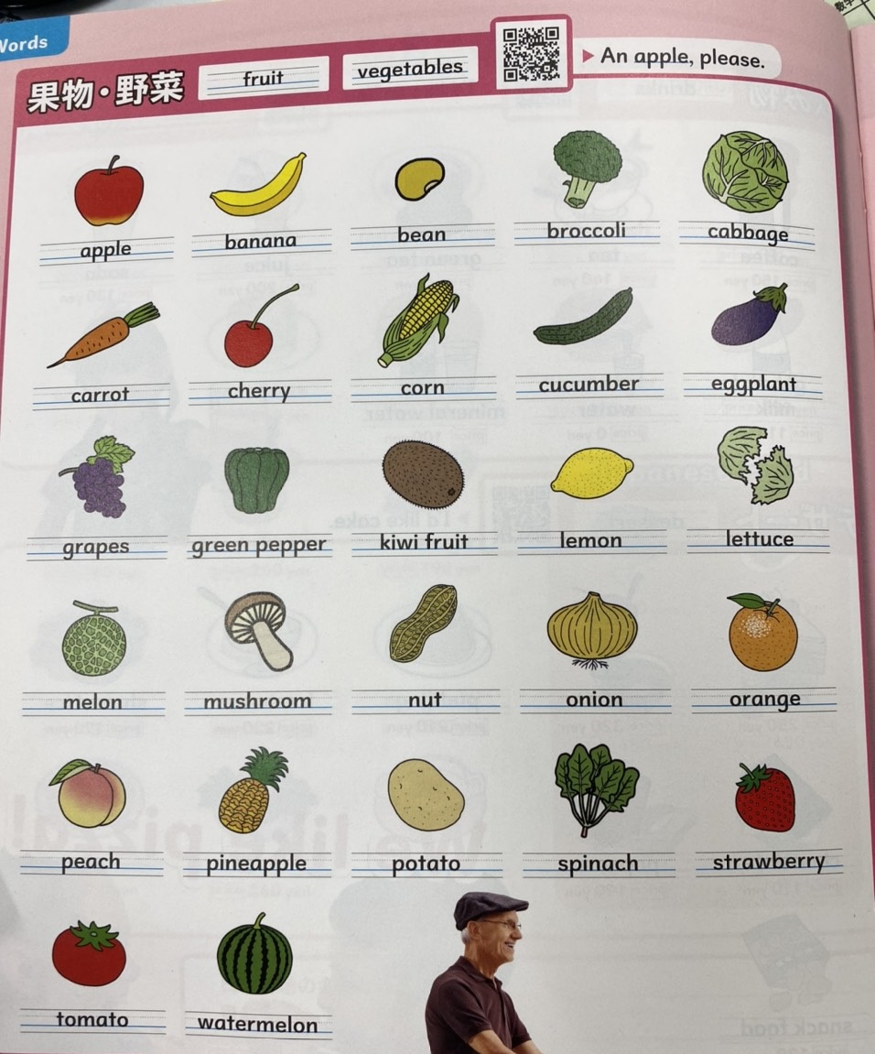
What fruit do you like?

Slide 9
What fruit do you like?

Slide 10
What vegetable do you like?

Slide 11
What vegetable do you like?

Slide 12
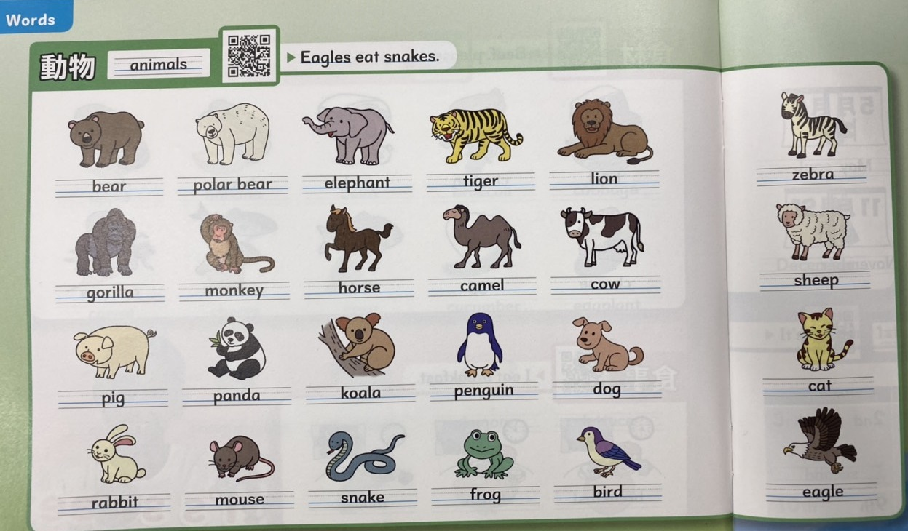
What animal do you like?

Slide 13
What animal do you like?

Slide 14
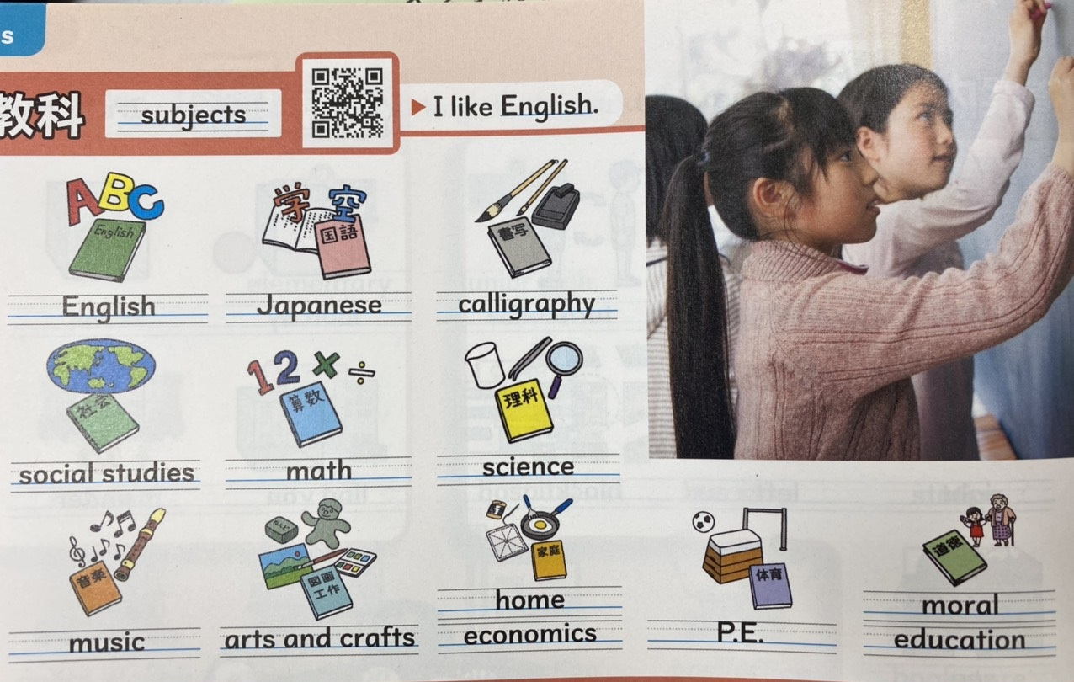
What subject do you like?

Slide 15
What subject do you like?

