Slide 1
Notes:
This template is for educational, non-commercial purposes only. For more free game templates like this one, visit https://www.taysteachingtoolkit.com

Slide 2
CHOOSE A LETTER & ANSWER A QUESTION.

Slide 3
IF YOU’RE RIGHT, YOU CAN PLAY A CARD GAME FOR POINTS!

Slide 4
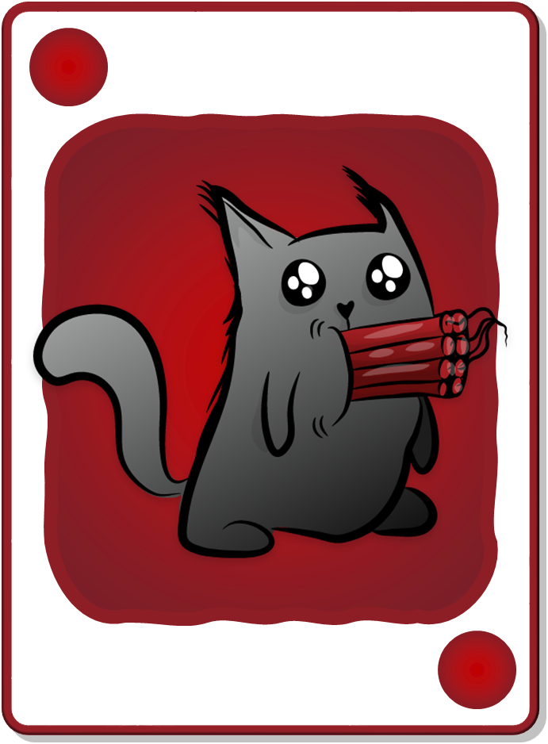
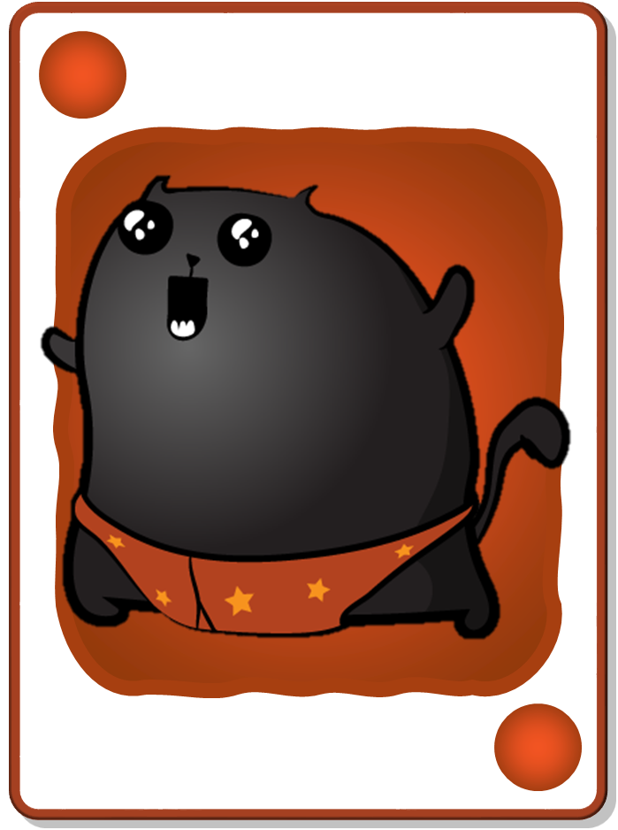
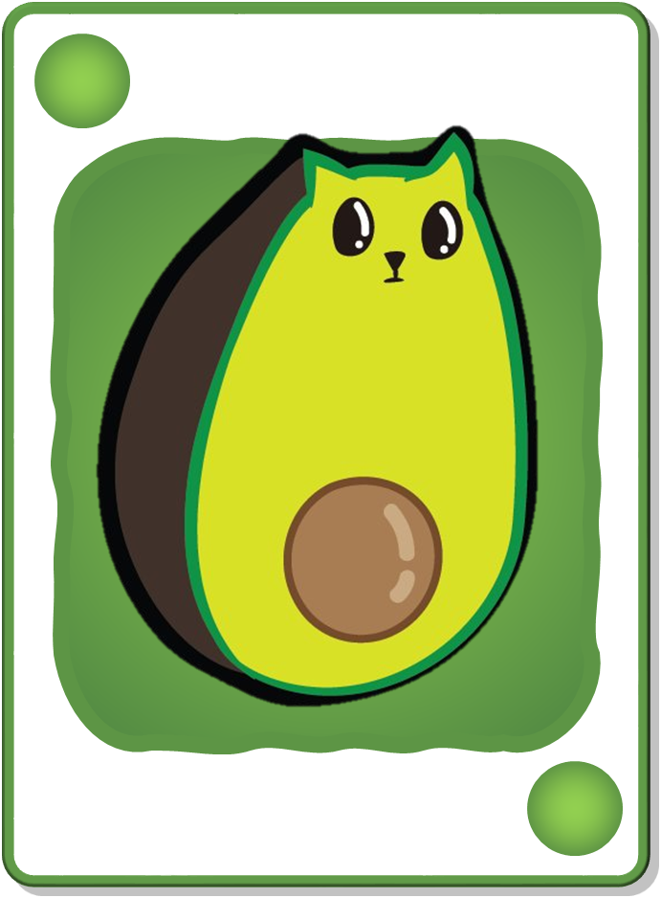
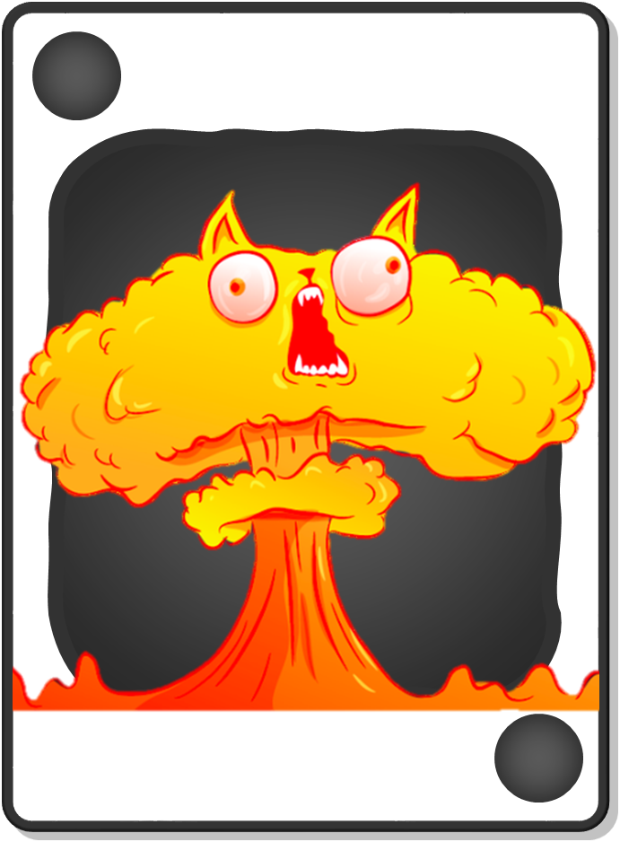
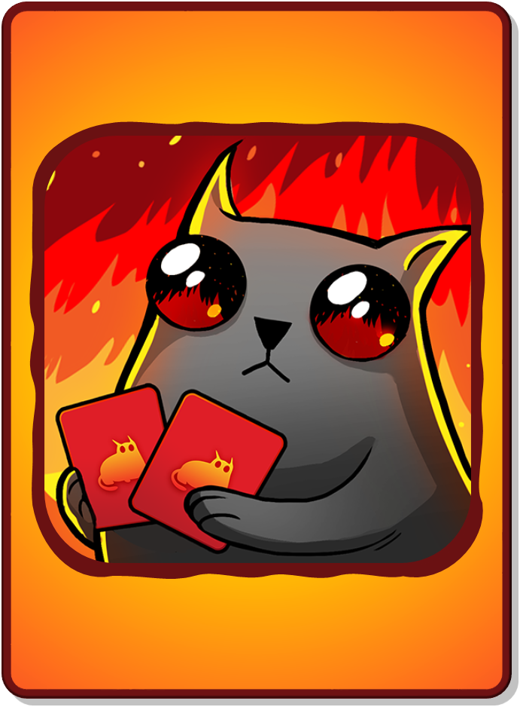
DECK CARDS
+1 POINT
+2 POINTS
+3 POINTS
+4 POINTS
+5 POINTS
BOMB!
NUCLEAR!
+1 POINT
+2 POINTS
+3 POINTS
+4 POINTS
+5 POINTS
BOMB!
NUCLEAR!
All teams lose all points!
LOSE ALL POINTS!
CHANGE POINTS!
Only your team loses all their points!
RARE CARDS
(not in deck)
LSOE ALL POINTS!
CHANGE POINTS!
Notes:
“Rare cards” cannot be found in the decks where students accumulate points. They’re a separate reward event (see reward slides for details).

Slide 5
A
B
C
D
E
CHOOSE A LETTER
F
G
H
I
J
K
L
M
N
O
P
Q
R
S
T
U
V
W
X
Y
Z
Notes:
A student/team chooses a letter.
Click the letter they choose to go to the corresponding question slide.

Slide 6
What color do you like?
I like ~
Notes:
Click the spacebar to make the ANSWER appear.
The blank space in the middle is for any extra text/images you need.
Click the green button to go to the reward slide.
Click the red button to go back to the question-choosing slide.
Background wood texture by vector.satrian on https://www.vecteezy.com

Slide 7
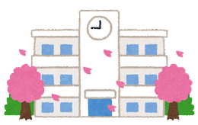
What fruit do you like?
I like ~
Notes:
Click the spacebar to make the ANSWER appear.
The blank space in the middle is for any extra text/images you need.
Click the green button to go to the reward slide.
Click the red button to go back to the question-choosing slide.
Background wood texture by vector.satrian on https://www.vecteezy.com

Slide 8
What sport do you like?
I like ~
Notes:
Click the spacebar to make the ANSWER appear.
The blank space in the middle is for any extra text/images you need.
Click the green button to go to the reward slide.
Click the red button to go back to the question-choosing slide.
Background wood texture by vector.satrian on https://www.vecteezy.com

Slide 9
Where do you want to go?
I want to go to ~
Notes:
Click the spacebar to make the ANSWER appear.
The blank space in the middle is for any extra text/images you need.
Click the green button to go to the reward slide.
Click the red button to go back to the question-choosing slide.
Background wood texture by vector.satrian on https://www.vecteezy.com

Slide 10
What time is it?
It’s 3
Notes:
Click the spacebar to make the ANSWER appear.
The blank space in the middle is for any extra text/images you need.
Click the green button to go to the reward slide.
Click the red button to go back to the question-choosing slide.
Background wood texture by vector.satrian on https://www.vecteezy.com

Slide 11
What time is it?
It’s 8:30
Notes:
Click the spacebar to make the ANSWER appear.
The blank space in the middle is for any extra text/images you need.
Click the green button to go to the reward slide.
Click the red button to go back to the question-choosing slide.
Background wood texture by vector.satrian on https://www.vecteezy.com

Slide 12
What’s the date?
It’s April 1st
Notes:
Click the spacebar to make the ANSWER appear.
The blank space in the middle is for any extra text/images you need.
Click the green button to go to the reward slide.
Click the red button to go back to the question-choosing slide.
Background wood texture by vector.satrian on https://www.vecteezy.com

Slide 13
When is your birthday?
It’s ~
Notes:
Click the spacebar to make the ANSWER appear.
The blank space in the middle is for any extra text/images you need.
Click the green button to go to the reward slide.
Click the red button to go back to the question-choosing slide.
Background wood texture by vector.satrian on https://www.vecteezy.com

Slide 14
How do you say 水曜日in English?
Wednesday
Notes:
Click the spacebar to make the ANSWER appear.
The blank space in the middle is for any extra text/images you need.
Click the green button to go to the reward slide.
Click the red button to go back to the question-choosing slide.
Background wood texture by vector.satrian on https://www.vecteezy.com

Slide 15
How do you say 木曜日in English?
Thursday
Notes:
Click the spacebar to make the ANSWER appear.
The blank space in the middle is for any extra text/images you need.
Click the green button to go to the reward slide.
Click the red button to go back to the question-choosing slide.
Background wood texture by vector.satrian on https://www.vecteezy.com

Slide 16
How do you say Tuesday in Japanese?
火曜日
Notes:
Click the spacebar to make the ANSWER appear.
The blank space in the middle is for any extra text/images you need.
Click the green button to go to the reward slide.
Click the red button to go back to the question-choosing slide.
Background wood texture by vector.satrian on https://www.vecteezy.com

Slide 17
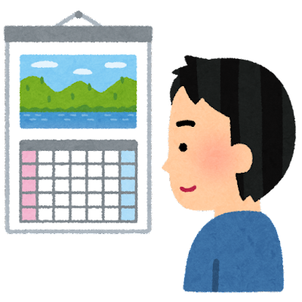
What month is it?
It’s April
Notes:
Click the spacebar to make the ANSWER appear.
The blank space in the middle is for any extra text/images you need.
Click the green button to go to the reward slide.
Click the red button to go back to the question-choosing slide.
Background wood texture by vector.satrian on https://www.vecteezy.com

Slide 18
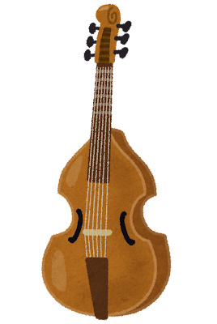
Do you play an instrument?
Yes, I do / No, I don’t
Notes:
Click the spacebar to make the ANSWER appear.
The blank space in the middle is for any extra text/images you need.
Click the green button to go to the reward slide.
Click the red button to go back to the question-choosing slide.
Background wood texture by vector.satrian on https://www.vecteezy.com

Slide 19
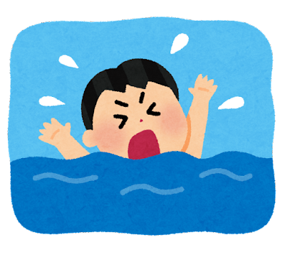
Can you swim well?
Yes, I can / No, I can’t
Notes:
Click the spacebar to make the ANSWER appear.
The blank space in the middle is for any extra text/images you need.
Click the green button to go to the reward slide.
Click the red button to go back to the question-choosing slide.
Background wood texture by vector.satrian on https://www.vecteezy.com

Slide 20
What subject do you like?
I like ~
Notes:
Click the spacebar to make the ANSWER appear.
The blank space in the middle is for any extra text/images you need.
Click the green button to go to the reward slide.
Click the red button to go back to the question-choosing slide.
Background wood texture by vector.satrian on https://www.vecteezy.com

Slide 21
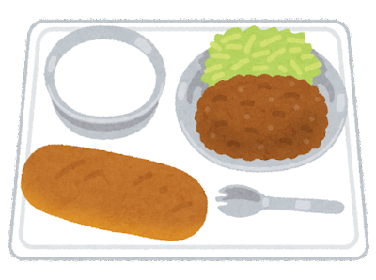
What do you want to eat?
I want ~
Notes:
Click the spacebar to make the ANSWER appear.
The blank space in the middle is for any extra text/images you need.
Click the green button to go to the reward slide.
Click the red button to go back to the question-choosing slide.
Background wood texture by vector.satrian on https://www.vecteezy.com

Slide 22
How do you spell your name?
Notes:
Click the spacebar to make the ANSWER appear.
The blank space in the middle is for any extra text/images you need.
Click the green button to go to the reward slide.
Click the red button to go back to the question-choosing slide.
Background wood texture by vector.satrian on https://www.vecteezy.com

Slide 23
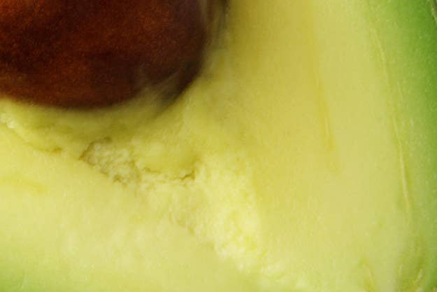
What’s this?
It’s a fruit, not a vegetable.
It’s green
It’s from America & South America
It’s an avocado
Notes:
Click the spacebar to make the ANSWER appear.
The blank space in the middle is for any extra text/images you need.
Click the green button to go to the reward slide.
Click the red button to go back to the question-choosing slide.
Background wood texture by vector.satrian on https://www.vecteezy.com

Slide 24
Can you play soccer?
Yes, I can / No, I can’t
Notes:
Click the spacebar to make the ANSWER appear.
The blank space in the middle is for any extra text/images you need.
Click the green button to go to the reward slide.
Click the red button to go back to the question-choosing slide.
Background wood texture by vector.satrian on https://www.vecteezy.com

Slide 25
Do you like tonkotsu ramen?
Yes, I do / No, I don’t
Notes:
Click the spacebar to make the ANSWER appear.
The blank space in the middle is for any extra text/images you need.
Click the green button to go to the reward slide.
Click the red button to go back to the question-choosing slide.
Background wood texture by vector.satrian on https://www.vecteezy.com

Slide 26
私は蕎麦を食べました
I ate soba
Notes:
Click the spacebar to make the ANSWER appear.
The blank space in the middle is for any extra text/images you need.
Click the green button to go to the reward slide.
Click the red button to go back to the question-choosing slide.
Background wood texture by vector.satrian on https://www.vecteezy.com

Slide 27
私はテレビを見ました
I watched TV
Notes:
Click the spacebar to make the ANSWER appear.
The blank space in the middle is for any extra text/images you need.
Click the green button to go to the reward slide.
Click the red button to go back to the question-choosing slide.
Background wood texture by vector.satrian on https://www.vecteezy.com

Slide 28
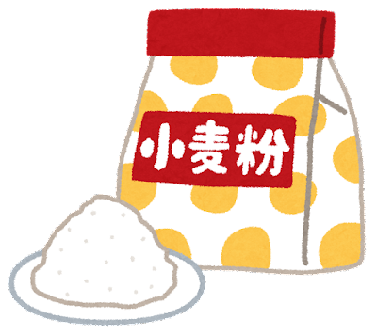
What are you doing?
I’m baking a cake
Notes:
Click the spacebar to make the ANSWER appear.
The blank space in the middle is for any extra text/images you need.
Click the green button to go to the reward slide.
Click the red button to go back to the question-choosing slide.
Background wood texture by vector.satrian on https://www.vecteezy.com

Slide 29
How many pens do you have?
~ pens / I have ~ pens
Notes:
Click the spacebar to make the ANSWER appear.
The blank space in the middle is for any extra text/images you need.
Click the green button to go to the reward slide.
Click the red button to go back to the question-choosing slide.
Background wood texture by vector.satrian on https://www.vecteezy.com

Slide 30
Do you have a dog?
Yes, I do / No, I don’t
Notes:
Click the spacebar to make the ANSWER appear.
The blank space in the middle is for any extra text/images you need.
Click the green button to go to the reward slide.
Click the red button to go back to the question-choosing slide.
Background wood texture by vector.satrian on https://www.vecteezy.com

Slide 31
What food don’t you like?
I don’t like ~
Notes:
Click the spacebar to make the ANSWER appear.
The blank space in the middle is for any extra text/images you need.
Click the green button to go to the reward slide.
Click the red button to go back to the question-choosing slide.
Background wood texture by vector.satrian on https://www.vecteezy.com

Slide 32
+4 POINTS
+1 POINT
BOMB!
+3 POINTS
Total Points:
0
3
7
8
+3 POINTS
+1 POINT
+4 POINTS
BOMB!
Notes:
Press the spacebar to reveal the first card.
Ask the student/team if they want to take the total points they have so far or draw again to possibly add more points.
I usually have my students say “keep going” (draw again) or “stop” (take the points they’ve accumulated).
Repeat this process until they either decide to take their accumulated points or reach a Bomb or Nuclear card.
Click the ABC Cat icon in the right-hand corner to go back the question-choosing slide.
Background wood texture by vector.satrian on https://www.vecteezy.com

Slide 33
NUCLEAR!
+2 POINTS
+1 POINT
+1 POINT
+3 POINTS
Total Points:
0
3
4
5
7
+3 POINTS
+1 POINT
+1 POINT
NUCLEAR!
+2 POINTS
Notes:
Press the spacebar to reveal the first card.
Ask the student/team if they want to take the total points they have so far or draw again to possibly add more points.
I usually have my students say “keep going” (draw again) or “stop” (take the points they’ve accumulated).
Repeat this process until they either decide to take their accumulated points or reach a Bomb or Nuclear card.
Click the ABC Cat icon in the right-hand corner to go back the question-choosing slide.
Background wood texture by vector.satrian on https://www.vecteezy.com

Slide 34
+2 POINTS
BOMB!
+3 POINTS
Total Points:
0
3
5
+3 POINTS
+2 POINTS
BOMB!
Notes:
Press the spacebar to reveal the first card.
Ask the student/team if they want to take the total points they have so far or draw again to possibly add more points.
I usually have my students say “keep going” (draw again) or “stop” (take the points they’ve accumulated).
Repeat this process until they either decide to take their accumulated points or reach a Bomb or Nuclear card.
Click the ABC Cat icon in the right-hand corner to go back the question-choosing slide.
Background wood texture by vector.satrian on https://www.vecteezy.com

Slide 35
CHANGE POINTS!
YOU FOUND A RARE CARD!
Reveal it or get 5 points?
CHANGE POINTS!
Notes:
The student/team has a choice: They can either get 5 points or take a chance and reveal the rare card, from which they will either lose all their points or get to change points with another team.
Press the spacebar to reveal the card, if they choose that option.
Click the ABC Cat icon in the right-hand corner to go back the question-choosing slide.
Background wood texture by vector.satrian on https://www.vecteezy.com

Slide 36
+2 POINTS
+1 POINT
+1 POINT
+1 POINT
+5 POINTS
BOMB!
Total Points:
10
0
1
6
7
9
+5 POINTS
+1 POINT
+1 POINT
+1 POINT
+2 POINTS
BOMB!
Notes:
Press the spacebar to reveal the first card.
Ask the student/team if they want to take the total points they have so far or draw again to possibly add more points.
I usually have my students say “keep going” (draw again) or “stop” (take the points they’ve accumulated).
Repeat this process until they either decide to take their accumulated points or reach a Bomb or Nuclear card.
Click the ABC Cat icon in the right-hand corner to go back the question-choosing slide.
Background wood texture by vector.satrian on https://www.vecteezy.com

Slide 37
NUCLEAR!
+2 POINTS
+2 POINTS
+5 POINTS
+3 POINTS
Total Points:
12
0
2
7
9
+5 POINTS
+3 POINTS
NUCLEAR!
+2 POINTS
+2 POINTS
Notes:
Press the spacebar to reveal the first card.
Ask the student/team if they want to take the total points they have so far or draw again to possibly add more points.
I usually have my students say “keep going” (draw again) or “stop” (take the points they’ve accumulated).
Repeat this process until they either decide to take their accumulated points or reach a Bomb or Nuclear card.
Click the ABC Cat icon in the right-hand corner to go back the question-choosing slide.
Background wood texture by vector.satrian on https://www.vecteezy.com

Slide 38
+2 POINTS
+2 POINTS
+2 POINTS
+2 POINTS
+1 POINT
BOMB!
+3 POINTS
Total Points:
12
0
2
4
6
7
9
+3 POINTS
+1 POINT
+2 POINTS
+2 POINTS
+2 POINTS
+2 POINTS
BOMB!
Notes:
Press the spacebar to reveal the first card.
Ask the student/team if they want to take the total points they have so far or draw again to possibly add more points.
I usually have my students say “keep going” (draw again) or “stop” (take the points they’ve accumulated).
Repeat this process until they either decide to take their accumulated points or reach a Bomb or Nuclear card.
Click the ABC Cat icon in the right-hand corner to go back the question-choosing slide.
Background wood texture by vector.satrian on https://www.vecteezy.com

Slide 39
+4 POINTS
BOMB!
Total Points:
0
4
+4 POINTS
BOMB!
Notes:
Press the spacebar to reveal the first card.
Ask the student/team if they want to take the total points they have so far or draw again to possibly add more points.
I usually have my students say “keep going” (draw again) or “stop” (take the points they’ve accumulated).
Repeat this process until they either decide to take their accumulated points or reach a Bomb or Nuclear card.
Click the ABC Cat icon in the right-hand corner to go back the question-choosing slide.
Background wood texture by vector.satrian on https://www.vecteezy.com

Slide 40
LOSE ALL POINTS!
YOU FOUND A RARE CARD!
Reveal it or get 5 points?
LSOE ALL POINTS!
Notes:
The student/team has a choice: They can either get 5 points or take a chance and reveal the rare card, from which they will either lose all their points or get to change points with another team.
Press the spacebar to reveal the card, if they choose that option.
Click the ABC Cat icon in the right-hand corner to go back the question-choosing slide.
Background wood texture by vector.satrian on https://www.vecteezy.com

Slide 41
+4 POINTS
BOMB!
+3 POINTS
+3 POINTS
Total Points:
10
0
3
7
+3 POINTS
+3 POINTS
+4 POINTS
BOMB!
Notes:
Press the spacebar to reveal the first card.
Ask the student/team if they want to take the total points they have so far or draw again to possibly add more points.
I usually have my students say “keep going” (draw again) or “stop” (take the points they’ve accumulated).
Repeat this process until they either decide to take their accumulated points or reach a Bomb or Nuclear card.
Click the ABC Cat icon in the right-hand corner to go back the question-choosing slide.
Background wood texture by vector.satrian on https://www.vecteezy.com

Slide 42
+4 POINTS
+2 POINTS
BOMB!
+3 POINTS
Total Points:
0
3
7
9
+3 POINTS
+4 POINTS
+2 POINTS
BOMB!
Notes:
Press the spacebar to reveal the first card.
Ask the student/team if they want to take the total points they have so far or draw again to possibly add more points.
I usually have my students say “keep going” (draw again) or “stop” (take the points they’ve accumulated).
Repeat this process until they either decide to take their accumulated points or reach a Bomb or Nuclear card.
Click the ABC Cat icon in the right-hand corner to go back the question-choosing slide.
Background wood texture by vector.satrian on https://www.vecteezy.com

Slide 43
CHANGE POINTS!
YOU FOUND A RARE CARD!
Reveal it or get 5 points?
CHANGE POINTS!
Notes:
The student/team has a choice: They can either get 5 points or take a chance and reveal the rare card, from which they will either lose all their points or get to change points with another team.
Press the spacebar to reveal the card, if they choose that option.
Click the ABC Cat icon in the right-hand corner to go back the question-choosing slide.
Background wood texture by vector.satrian on https://www.vecteezy.com

Slide 44
NUCLEAR!
+4 POINTS
+2 POINTS
+2 POINTS
+1 POINT
+3 POINTS
+3 POINTS
Total Points:
15
12
0
2
6
7
9
+3 POINTS
+3 POINTS
+1 POINT
+4 POINTS
NUCLEAR!
+2 POINTS
+2 POINTS
Notes:
Press the spacebar to reveal the first card.
Ask the student/team if they want to take the total points they have so far or draw again to possibly add more points.
I usually have my students say “keep going” (draw again) or “stop” (take the points they’ve accumulated).
Repeat this process until they either decide to take their accumulated points or reach a Bomb or Nuclear card.
Click the ABC Cat icon in the right-hand corner to go back the question-choosing slide.
Background wood texture by vector.satrian on https://www.vecteezy.com

Slide 45
+5 POINTS
BOMB!
Total Points:
0
5
+5 POINTS
BOMB!
Notes:
Press the spacebar to reveal the first card.
Ask the student/team if they want to take the total points they have so far or draw again to possibly add more points.
I usually have my students say “keep going” (draw again) or “stop” (take the points they’ve accumulated).
Repeat this process until they either decide to take their accumulated points or reach a Bomb or Nuclear card.
Click the ABC Cat icon in the right-hand corner to go back the question-choosing slide.
Background wood texture by vector.satrian on https://www.vecteezy.com

Slide 46
+4 POINTS
+2 POINTS
+1 POINT
+5 POINTS
BOMB!
Total Points:
12
0
1
3
8
+5 POINTS
+1 POINT
+4 POINTS
+2 POINTS
BOMB!
Notes:
Press the spacebar to reveal the first card.
Ask the student/team if they want to take the total points they have so far or draw again to possibly add more points.
I usually have my students say “keep going” (draw again) or “stop” (take the points they’ve accumulated).
Repeat this process until they either decide to take their accumulated points or reach a Bomb or Nuclear card.
Click the ABC Cat icon in the right-hand corner to go back the question-choosing slide.
Background wood texture by vector.satrian on https://www.vecteezy.com

Slide 47
LOSE ALL POINTS!
YOU FOUND A RARE CARD!
Reveal it or get 5 points?
LSOE ALL POINTS!
Notes:
The student/team has a choice: They can either get 5 points or take a chance and reveal the rare card, from which they will either lose all their points or get to change points with another team.
Press the spacebar to reveal the card, if they choose that option.
Click the ABC Cat icon in the right-hand corner to go back the question-choosing slide.
Background wood texture by vector.satrian on https://www.vecteezy.com

Slide 48
LOSE ALL POINTS!
YOU FOUND A RARE CARD!
Reveal it or get 5 points?
LSOE ALL POINTS!
Notes:
The student/team has a choice: They can either get 5 points or take a chance and reveal the rare card, from which they will either lose all their points or get to change points with another team.
Press the spacebar to reveal the card, if they choose that option.
Click the ABC Cat icon in the right-hand corner to go back the question-choosing slide.
Background wood texture by vector.satrian on https://www.vecteezy.com

Slide 49
+2 POINTS
+2 POINTS
BOMB!
Total Points:
0
2
4
+2 POINTS
+2 POINTS
BOMB!
Notes:
Press the spacebar to reveal the first card.
Ask the student/team if they want to take the total points they have so far or draw again to possibly add more points.
I usually have my students say “keep going” (draw again) or “stop” (take the points they’ve accumulated).
Repeat this process until they either decide to take their accumulated points or reach a Bomb or Nuclear card.
Click the ABC Cat icon in the right-hand corner to go back the question-choosing slide.
Background wood texture by vector.satrian on https://www.vecteezy.com

Slide 50
NUCLEAR!
+4 POINTS
+2 POINTS
+1 POINT
+5 POINTS
+3 POINTS
Total Points:
15
14
11
0
5
7
+5 POINTS
+3 POINTS
+1 POINT
+4 POINTS
NUCLEAR!
+2 POINTS
Notes:
Press the spacebar to reveal the first card.
Ask the student/team if they want to take the total points they have so far or draw again to possibly add more points.
I usually have my students say “keep going” (draw again) or “stop” (take the points they’ve accumulated).
Repeat this process until they either decide to take their accumulated points or reach a Bomb or Nuclear card.
Click the ABC Cat icon in the right-hand corner to go back the question-choosing slide.
Background wood texture by vector.satrian on https://www.vecteezy.com

Slide 51
+1 POINT
+1 POINT
+1 POINT
BOMB!
Total Points:
0
1
2
3
+1 POINT
+1 POINT
+1 POINT
BOMB!
Notes:
Press the spacebar to reveal the first card.
Ask the student/team if they want to take the total points they have so far or draw again to possibly add more points.
I usually have my students say “keep going” (draw again) or “stop” (take the points they’ve accumulated).
Repeat this process until they either decide to take their accumulated points or reach a Bomb or Nuclear card.
Click the ABC Cat icon in the right-hand corner to go back the question-choosing slide.
Background wood texture by vector.satrian on https://www.vecteezy.com

Slide 52
+2 POINTS
+2 POINTS
+1 POINT
+5 POINTS
BOMB!
+3 POINTS
+3 POINTS
Total Points:
10
11
16
0
2
4
7
+5 POINTS
+3 POINTS
+3 POINTS
+1 POINT
+2 POINTS
+2 POINTS
BOMB!
Notes:
Press the spacebar to reveal the first card.
Ask the student/team if they want to take the total points they have so far or draw again to possibly add more points.
I usually have my students say “keep going” (draw again) or “stop” (take the points they’ve accumulated).
Repeat this process until they either decide to take their accumulated points or reach a Bomb or Nuclear card.
Click the ABC Cat icon in the right-hand corner to go back the question-choosing slide.
Background wood texture by vector.satrian on https://www.vecteezy.com

Slide 53
CHANGE POINTS!
YOU FOUND A RARE CARD!
Reveal it or get 5 points?
CHANGE POINTS!
Notes:
The student/team has a choice: They can either get 5 points or take a chance and reveal the rare card, from which they will either lose all their points or get to change points with another team.
Press the spacebar to reveal the card, if they choose that option.
Click the ABC Cat icon in the right-hand corner to go back the question-choosing slide.
Background wood texture by vector.satrian on https://www.vecteezy.com

Slide 54
NUCLEAR!
+5 POINTS
+5 POINTS
+3 POINTS
Total Points:
10
13
0
5
+5 POINTS
+5 POINTS
+3 POINTS
NUCLEAR!
Notes:
Press the spacebar to reveal the first card.
Ask the student/team if they want to take the total points they have so far or draw again to possibly add more points.
I usually have my students say “keep going” (draw again) or “stop” (take the points they’ve accumulated).
Repeat this process until they either decide to take their accumulated points or reach a Bomb or Nuclear card.
Click the ABC Cat icon in the right-hand corner to go back the question-choosing slide.
Background wood texture by vector.satrian on https://www.vecteezy.com

Slide 55
+4 POINTS
+2 POINTS
+2 POINTS
+1 POINT
+1 POINT
+1 POINT
+1 POINT
+5 POINTS
BOMB!
+3 POINTS
Total Points:
20
13
18
11
12
19
0
3
5
7
+5 POINTS
+3 POINTS
+1 POINT
+1 POINT
+1 POINT
+1 POINT
+4 POINTS
+2 POINTS
+2 POINTS
BOMB!
Notes:
Press the spacebar to reveal the first card.
Ask the student/team if they want to take the total points they have so far or draw again to possibly add more points.
I usually have my students say “keep going” (draw again) or “stop” (take the points they’ve accumulated).
Repeat this process until they either decide to take their accumulated points or reach a Bomb or Nuclear card.
Click the ABC Cat icon in the right-hand corner to go back the question-choosing slide.
Background wood texture by vector.satrian on https://www.vecteezy.com

Slide 56
LOSE ALL POINTS!
YOU FOUND A RARE CARD!
Reveal it or get 5 points?
LSOE ALL POINTS!
Notes:
The student/team has a choice: They can either get 5 points or take a chance and reveal the rare card, from which they will either lose all their points or get to change points with another team.
Press the spacebar to reveal the card, if they choose that option.
Click the ABC Cat icon in the right-hand corner to go back the question-choosing slide.
Background wood texture by vector.satrian on https://www.vecteezy.com

Slide 57
+2 POINTS
+5 POINTS
BOMB!
+3 POINTS
Total Points:
10
0
5
7
+5 POINTS
+3 POINTS
+2 POINTS
BOMB!
Notes:
Press the spacebar to reveal the first card.
Ask the student/team if they want to take the total points they have so far or draw again to possibly add more points.
I usually have my students say “keep going” (draw again) or “stop” (take the points they’ve accumulated).
Repeat this process until they either decide to take their accumulated points or reach a Bomb or Nuclear card.
Click the ABC Cat icon in the right-hand corner to go back the question-choosing slide.
Background wood texture by vector.satrian on https://www.vecteezy.com

