Slide 1
POINT QUIZ

Slide 2
HOW TO PLAY

Slide 3
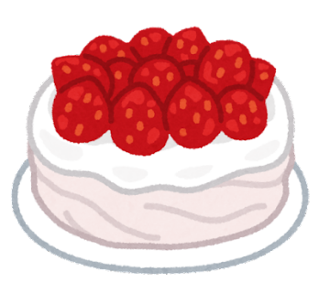
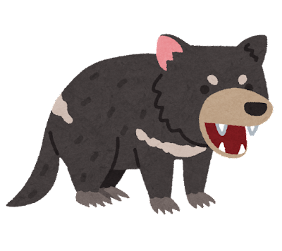
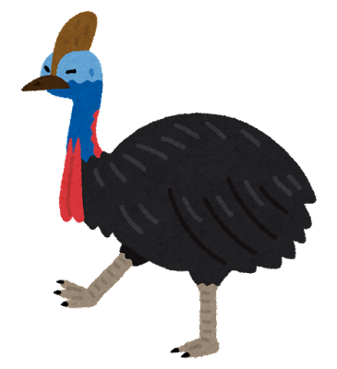
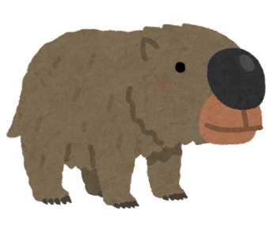
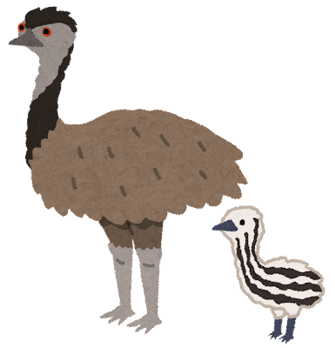
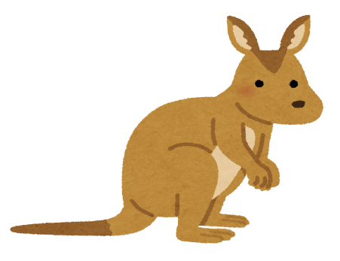
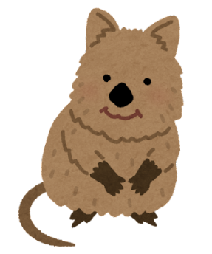
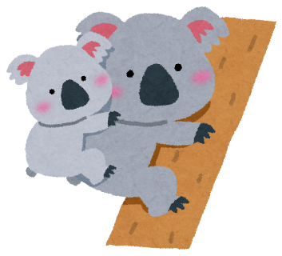
QUESTION
ANSWER
2
4
2
1
-2
wombat
pavlova
devil
uluru
cassowary
3
3
-1
1
quokka
koala
emu
kangaroo

Slide 4
READY?

Slide 5
QUESTION 1

Slide 6
3
1
-1
4
1
wombat
pavlova
devil
uluru
cassowary
2
-2
3
2
quokka
koala
emu
kangaroo

Slide 7
QUESTION 2

Slide 8
-2
3
1
1
2
wombat
pavlova
devil
uluru
cassowary
3
-1
2
4
quokka
koala
emu
kangaroo

Slide 9
QUESTION 3

Slide 10
1
2
2
-1
1
wombat
pavlova
devil
uluru
cassowary
-2
4
3
3
quokka
koala
emu
kangaroo

Slide 11
QUESTION 4

Slide 12
4
-1
3
2
3
wombat
pavlova
devil
uluru
cassowary
1
1
-2
2
quokka
koala
emu
kangaroo

Slide 13
QUESTION 5

Slide 14
4
1
2
-2
-1
wombat
pavlova
devil
uluru
cassowary
3
2
3
1
quokka
koala
emu
kangaroo

Slide 15
QUESTION 6

Slide 16
1
-2
4
3
2
wombat
pavlova
devil
uluru
cassowary
-1
1
2
3
quokka
koala
emu
kangaroo

Slide 17
QUESTION 7

Slide 18
2
4
2
1
-2
wombat
pavlova
devil
uluru
cassowary
3
3
-1
1
quokka
koala
emu
kangaroo

Slide 19
QUESTION 8

Slide 20
-2
1
2
1
4
wombat
pavlova
devil
uluru
cassowary
2
3
3
-1
quokka
koala
emu
kangaroo

Slide 21
QUESTION 9

Slide 22
3
1
-1
4
1
wombat
pavlova
devil
uluru
cassowary
2
-2
3
2
quokka
koala
emu
kangaroo

Slide 23
QUESTION 10

Slide 24
-2
3
1
1
2
wombat
pavlova
devil
uluru
cassowary
3
-1
2
4
quokka
koala
emu
kangaroo

Slide 25
QUESTION 11

Slide 26
1
2
2
-1
1
wombat
pavlova
devil
uluru
cassowary
-2
4
3
3
quokka
koala
emu
kangaroo

Slide 27
FINAL QUESTION

Slide 28
4
-1
3
2
3
wombat
pavlova
devil
uluru
cassowary
1
1
-2
2
quokka
koala
emu
kangaroo

Slide 29
FINISH!!

