Slide 1
The
Typhoon
Game!
Skip
demo

Slide 2
Demonstration!

Slide 3
1
2
3
A
?
?
?
B
?
?
?
C
?
?
?

Slide 5
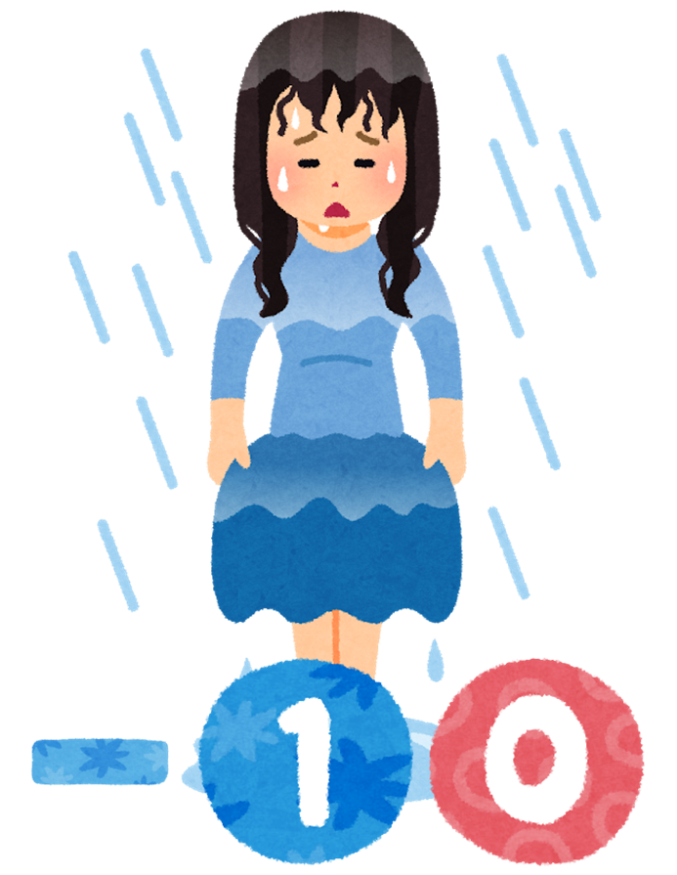
5 points!
15 points!
10 points!
Attack:
-10 points!
Your team:
-10 points!
All teams: -10 points!
One team:
Switch!
Double
points!

Slide 6
1
2
3
4
5
6
A
?
?
?
?
?
?
B
?
?
?
?
?
?
C
?
?
?
?
?
?
D
?
?
?
?
?
?
E
?
?
?
?
?
?
F
?
?
?
?
?
?

Slide 10
Attack!

Slide 11
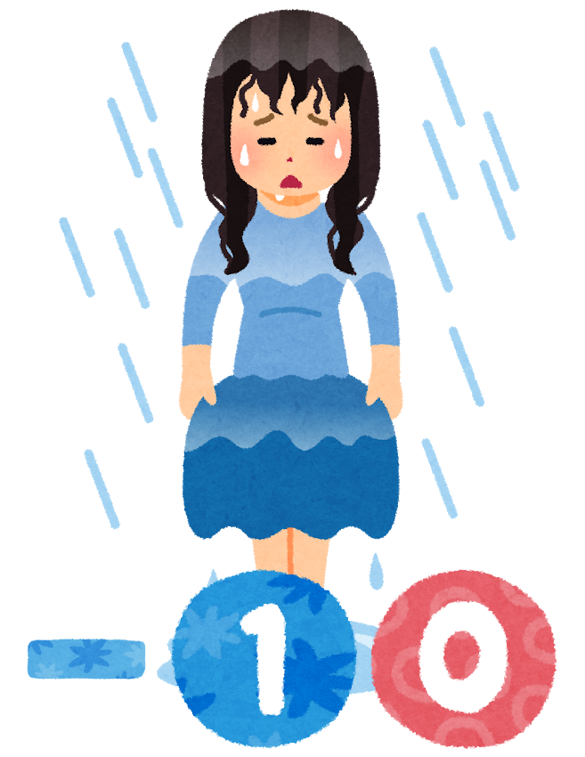

Slide 12
Reset!

Slide 15
1
2
3
A
?
?
?
B
?
?
?
C
?
?
?

Slide 16
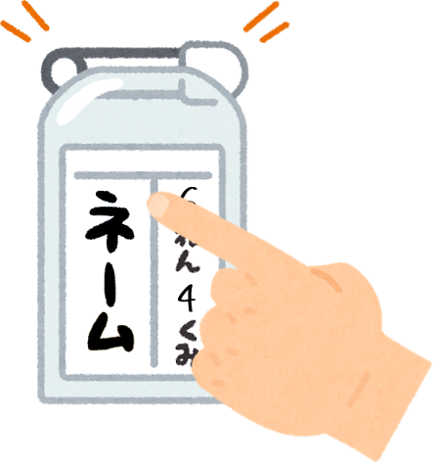
Example
Demonstration Question!
What’s your name?
My name is…
[???]!

Slide 18
5 points!
15 points!
10 points!
Attack:
-10 points!
Your team:
-10 points!
All teams: -10 points!
One team:
Switch!
Double
points!

Slide 19
1
2
3
4
5
6
A
?
?
?
?
?
?
B
?
?
?
?
?
?
C
?
?
?
?
?
?
D
?
?
?
?
?
?
E
?
?
?
?
?
?
F
?
?
?
?
?
?

Slide 20
G?U?
Title
Question
Hint
Answer

Slide 59
Attack!

Slide 61
Reset!

