Slide 1
What’s this?

Slide 2
Demonstration

Slide 3
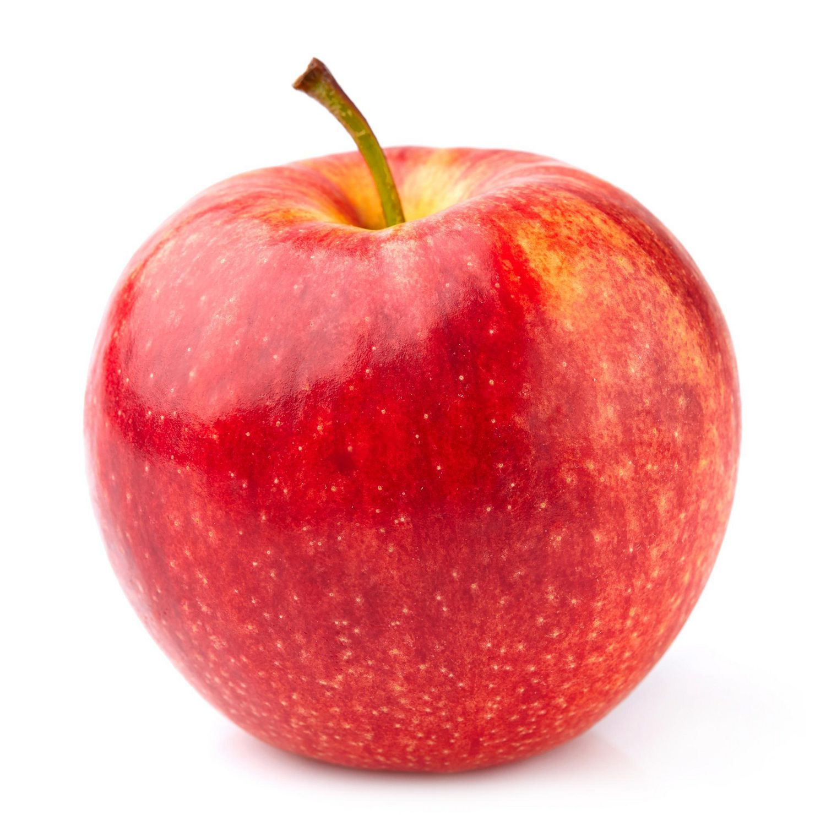
1
2
3
4
5
A
1
2
3
4
5
1
2
3
4
5
1
2
3
4
5

Slide 5
Ready?

Slide 6
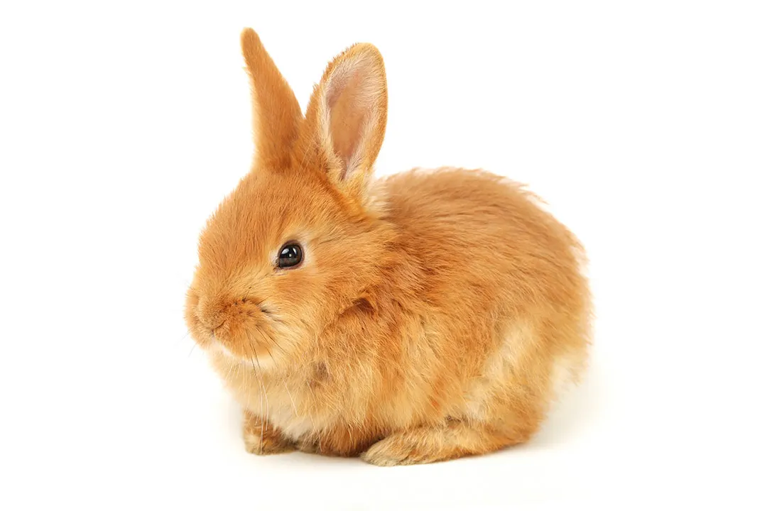
1
2
3
4
5
A
1
2
3
4
5
1
2
3
4
5
1
2
3
4
5

Slide 8
1
2
3
4
5
A
1
2
3
4
5
1
2
3
4
5
1
2
3
4
5

Slide 10
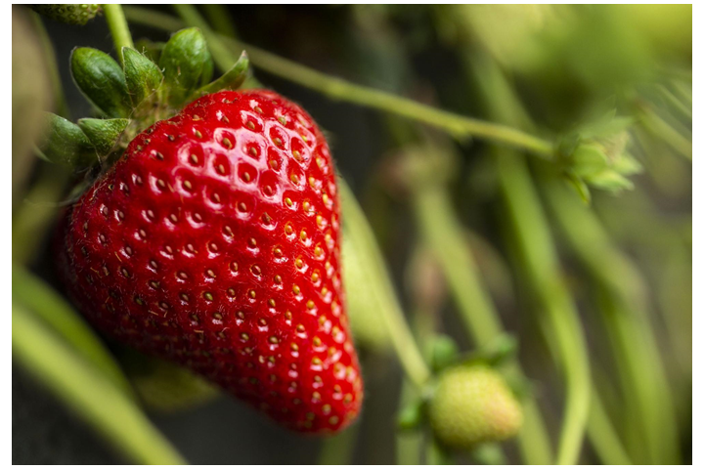
1
2
3
4
5
A
1
2
3
4
5
1
2
3
4
5
1
2
3
4
5

Slide 11
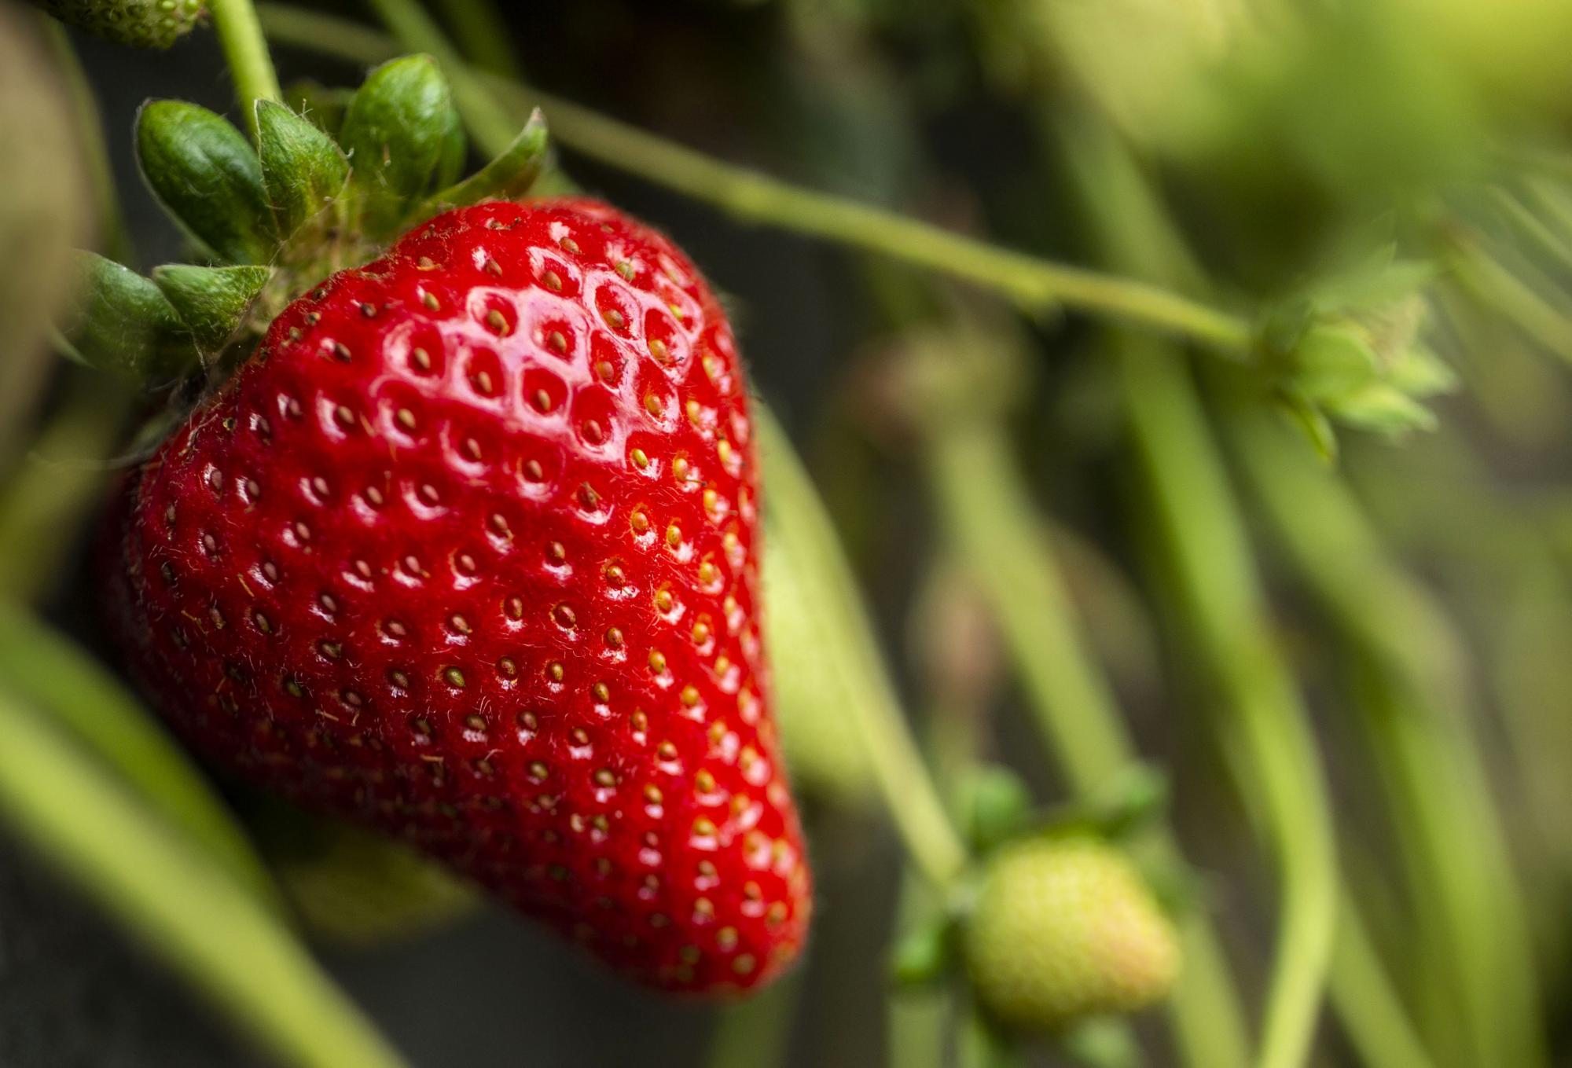

Slide 12
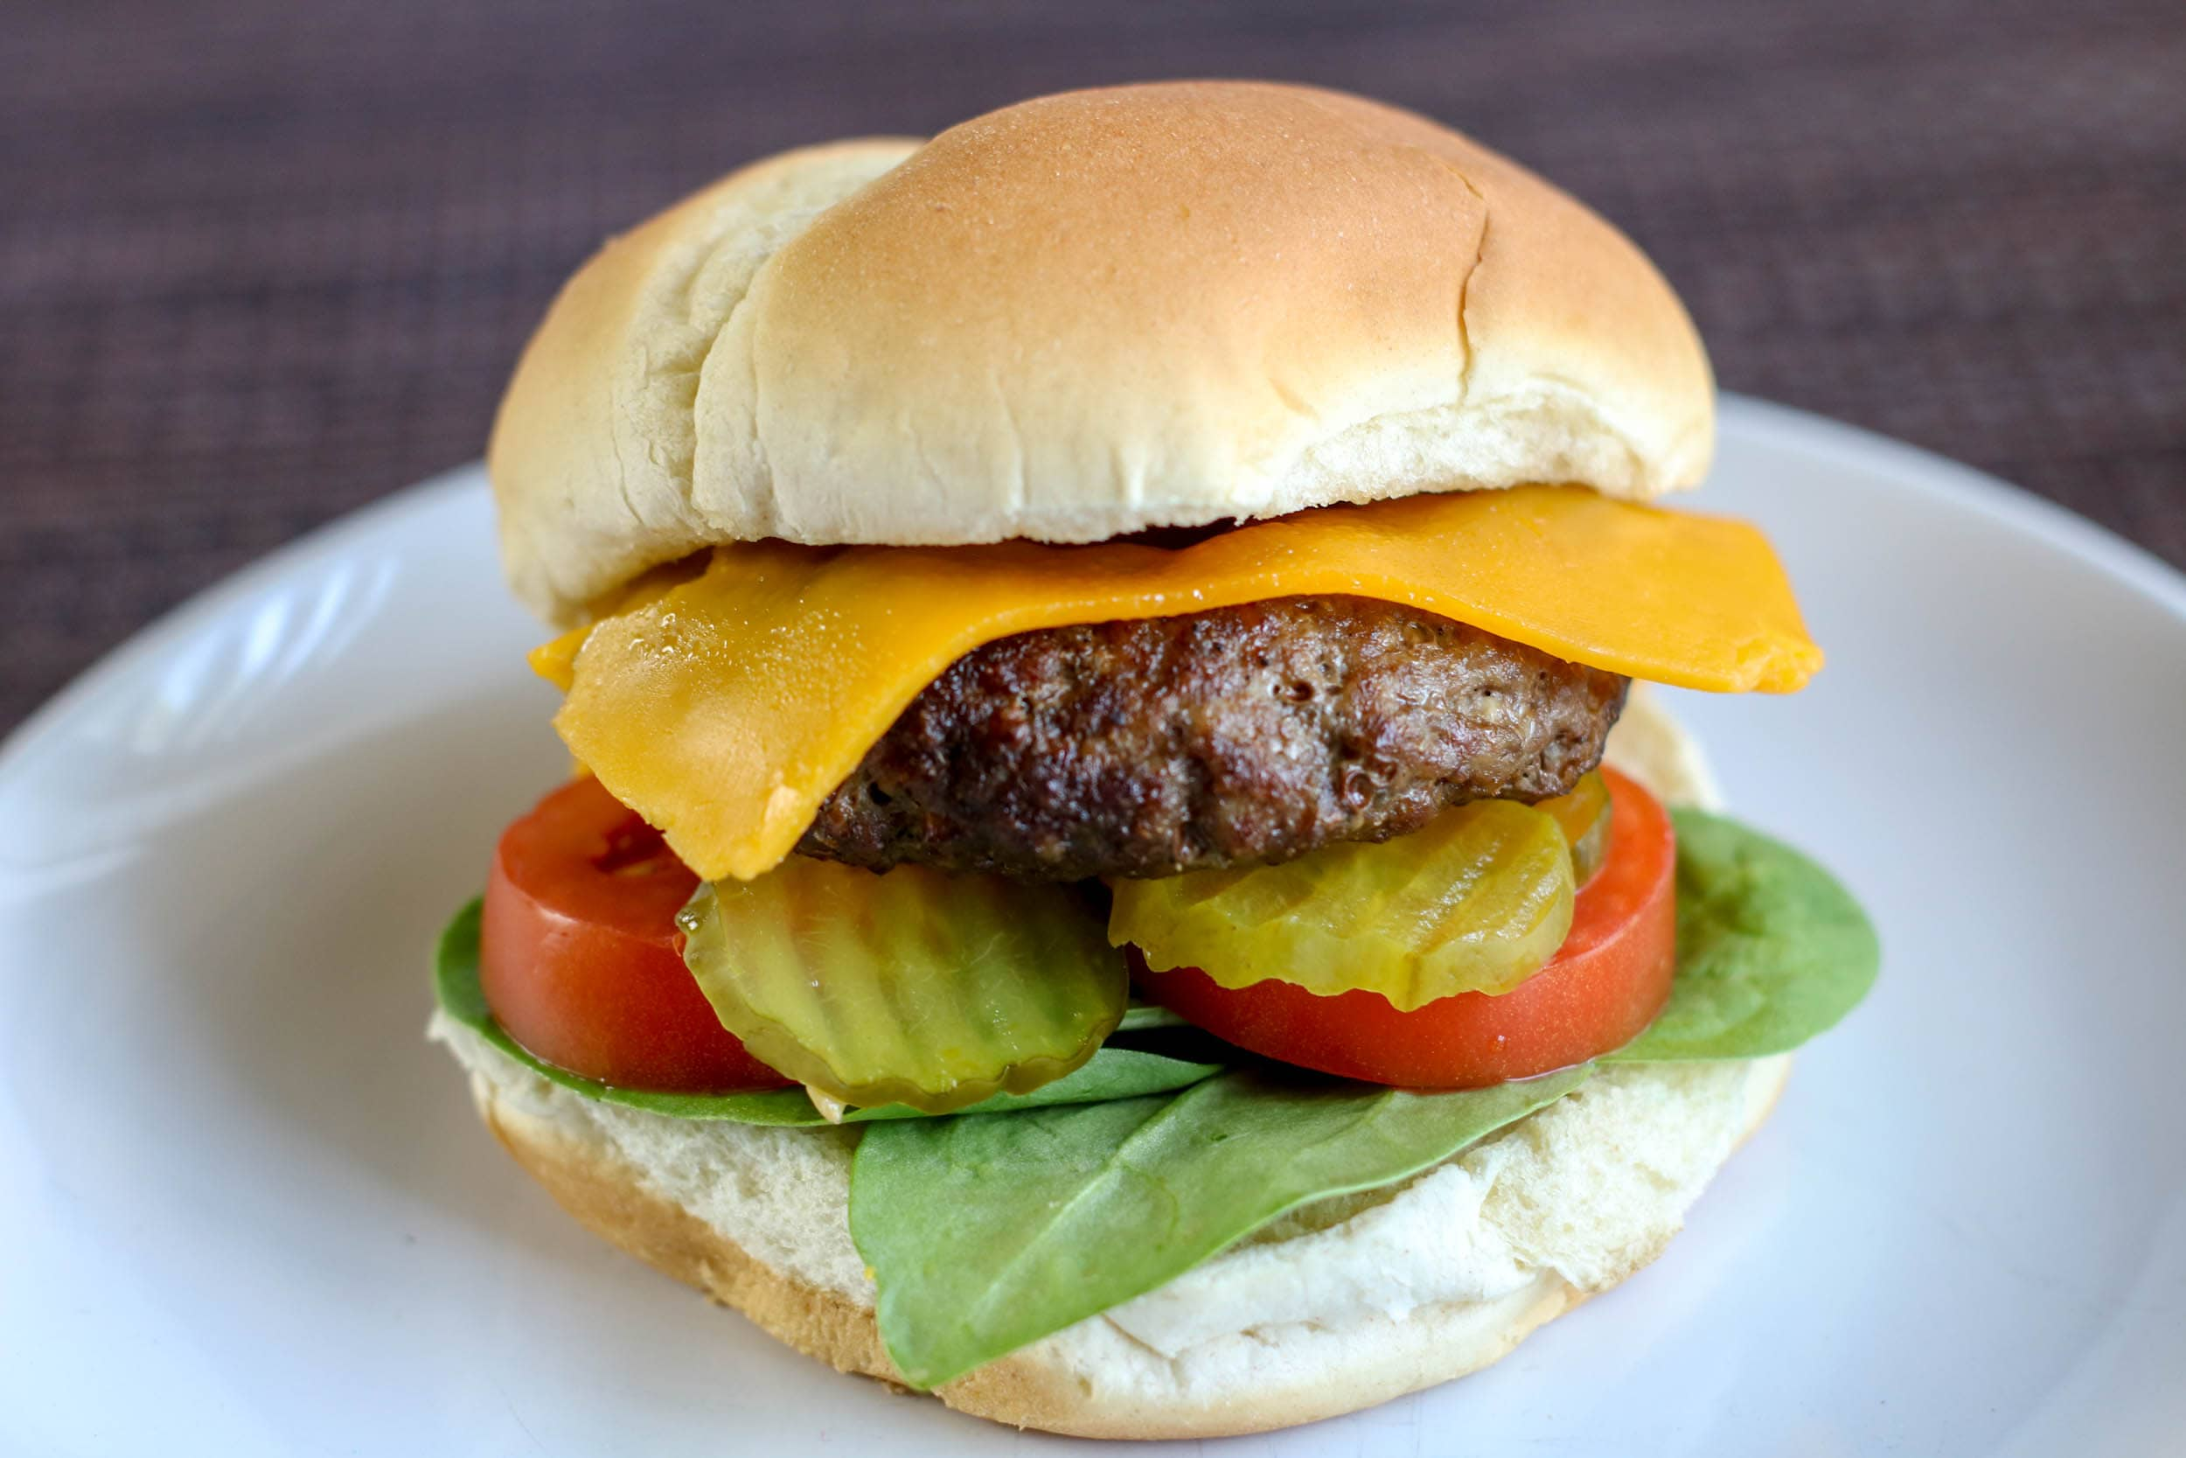
1
2
3
4
5
A
1
2
3
4
5
1
2
3
4
5
1
2
3
4
5

Slide 14
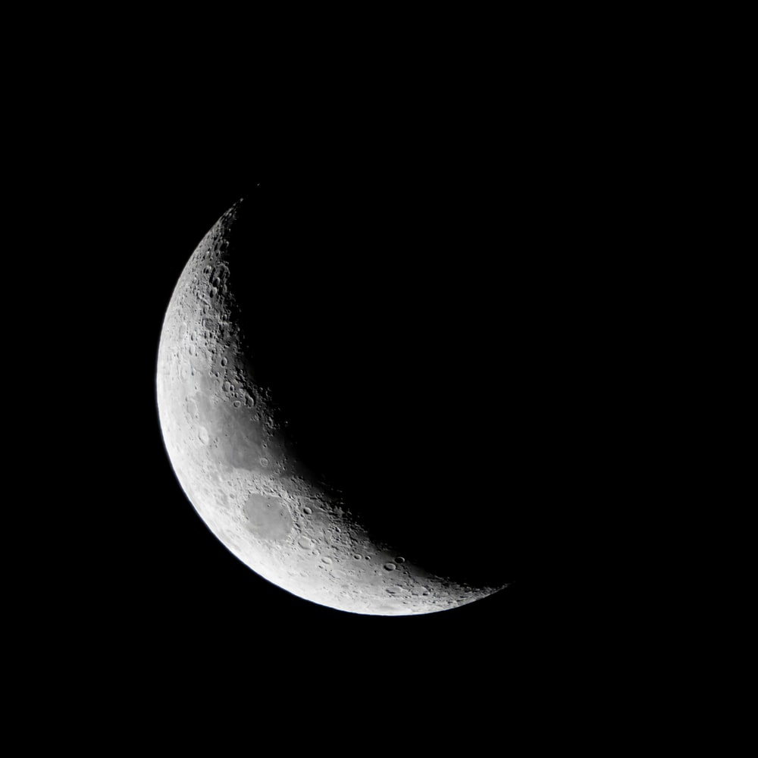
1
2
3
4
5
A
1
2
3
4
5
1
2
3
4
5
1
2
3
4
5

Slide 16
1
2
3
4
5
A
1
2
3
4
5
1
2
3
4
5
1
2
3
4
5

Slide 18
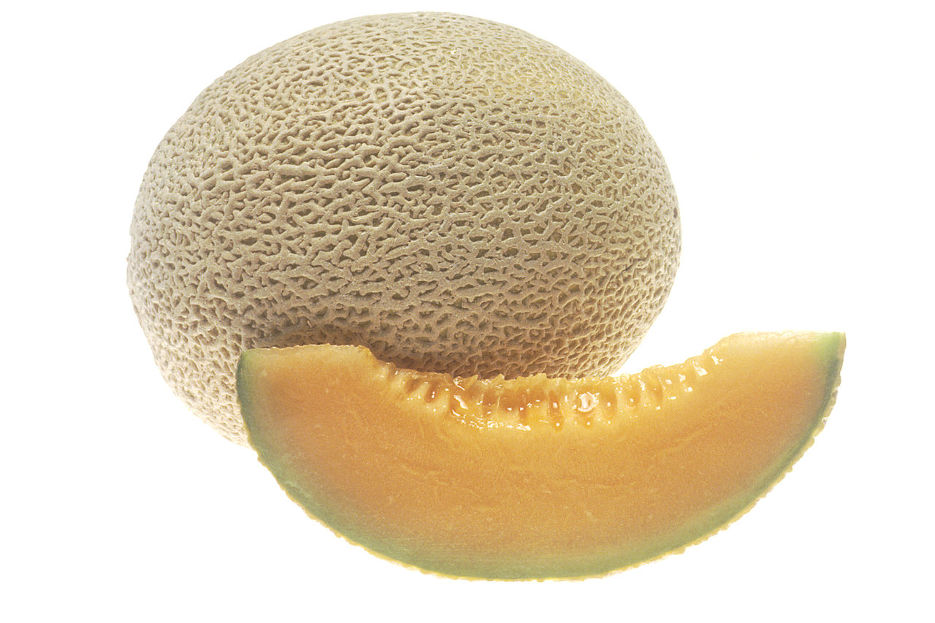
1
2
3
4
5
A
1
2
3
4
5
1
2
3
4
5
1
2
3
4
5

Slide 20
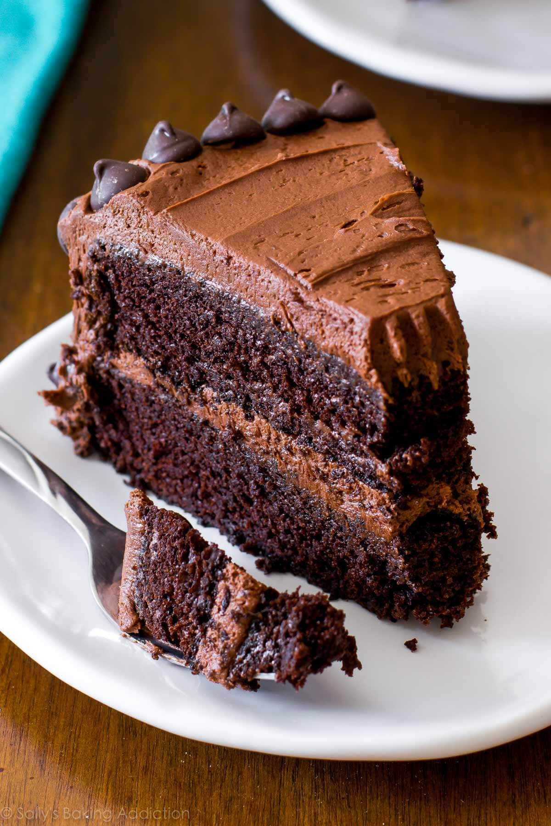
1
2
3
4
5
A
1
2
3
4
5
1
2
3
4
5
1
2
3
4
5

Slide 22
Finished!

Slide 23
1
2
3
4
5
A
1
2
3
4
5
1
2
3
4
5
1
2
3
4
5

