Slide 1
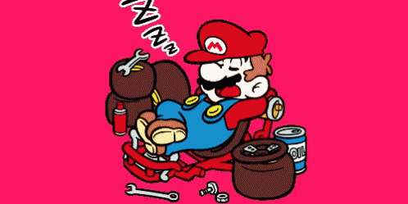
Asleep / Awake

Slide 2
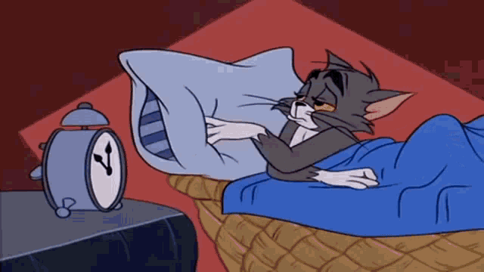
Everyone go to sleep!

Slide 3
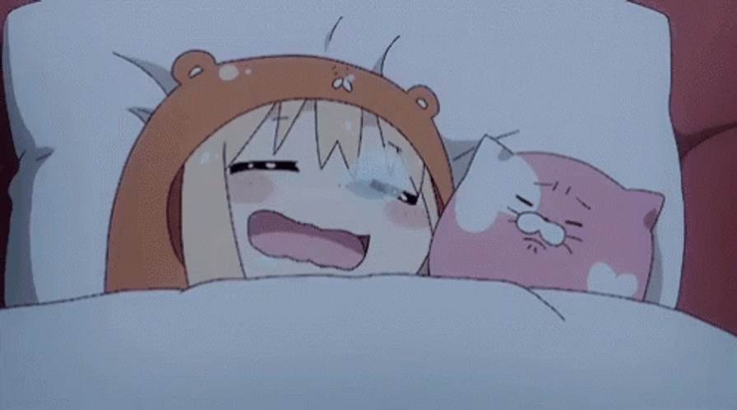
Player 1 wake up!
*word*

Slide 4
Player 2 wake up!
*word*

Slide 5
Player 3 wake up!
*word*

Slide 6
Player 4 wake up!
*word*

Slide 7
Player 5 wake up!
*word*

Slide 8
*answer*

Slide 9
Everyone go to sleep!

Slide 10
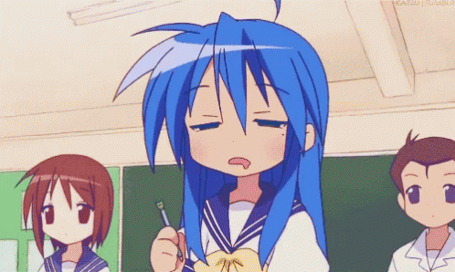
Player 1 wake up!
*word*

Slide 11
Player 2 wake up!
*word*

Slide 12
Player 3 wake up!
*word*

Slide 13
Player 4 wake up!
*word*

Slide 14
Player 5 wake up!
*word*

Slide 15
*ANSWER*

Slide 16
Everyone go to sleep!

Slide 17
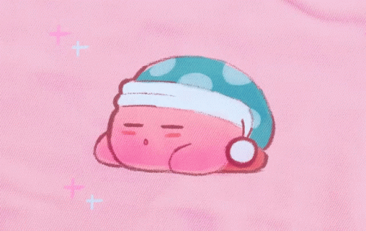
Player 1 wake up!
*word*
beaten

Slide 18
Player 2 wake up!
beaten
*word*

Slide 19
Player 3 wake up!
*word*
beaten

Slide 20
Player 4 wake up!
*word*
beaten

Slide 21
Player 5 wake up!
beaten
*word*

Slide 22
*ANSWER*

Slide 23
Everyone go to sleep!

Slide 24
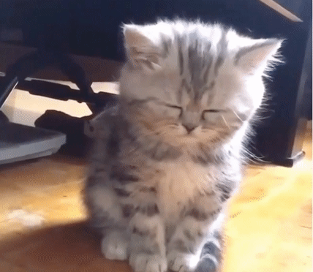
Player 1 wake up!
*word*
beaten

Slide 25
Player 2 wake up!
*word*
beaten

Slide 26
Player 3 wake up!
*word*
beaten

Slide 27
Player 4 wake up!
beaten
*word*

Slide 28
Player 5 wake up!
*word*
beaten

Slide 29
*Answer*

Slide 30
Everyone go to sleep!

Slide 31
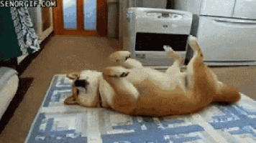
Player 1 wake up!
*word*

Slide 32
Player 2 wake up!
*word*

Slide 33
Player 3 wake up!
*word*

Slide 34
Player 4 wake up!
*word*

Slide 35
Player 5 wake up!
*word*

Slide 36
*word*

Slide 37
Everyone go to sleep!

Slide 38
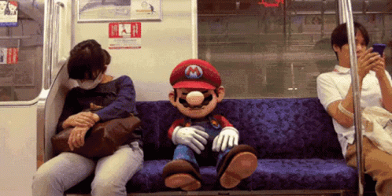
Player 1 wake up!
*word*

Slide 39
Player 2 wake up!
*word*

Slide 40
Player 3 wake up!
*word*

Slide 41
Player 4 wake up!
*word*

Slide 42
Player 5 wake up!
*word*

Slide 43
*ANSWER*

Slide 44
Everyone go to sleep!

Slide 45
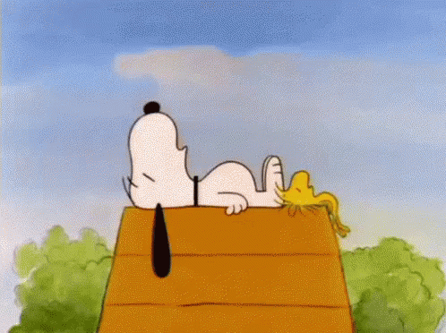
Player 1 wake up!
*word*

Slide 46
Player 2 wake up!
*word*

Slide 47
Player 3 wake up!
*word*

Slide 48
Player 4 wake up!
*word*

Slide 49
Player 5 wake up!
*word*

Slide 50
*ANSWER*

