Slide 1
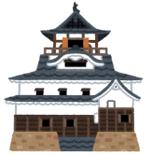
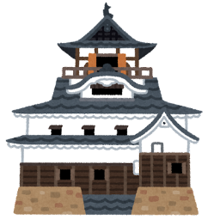
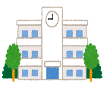
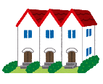
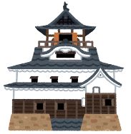
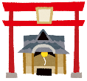
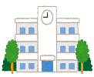
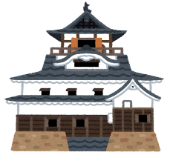
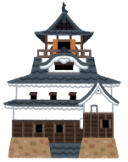
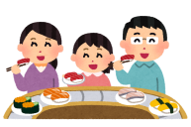
READY?
Question 10
Answer 10
Question 9
Answer 9
[WRITE QUESTION HERE]
[WRITE ANSWER HERE]
[WRITE QUESTION HERE]
Answer 1
[WRITE ANSWER HERE]
Question 1
[WRITE QUESTION HERE]
[WRITE ANSWER HERE]
BATTLE FOR FUJIEDA!
Question 8
Answer 8
10
1
4
5
6
7
8
3
9
Seihoku
2
Answer 2
TIME!
[WRITE QUESTION HERE]
[WRITE ANSWER HERE]
Question 2
Soccer
Stadium
Hanashi
JHS
[WRITE QUESTION HERE]
[WRITE ANSWER HERE]
Hanashi
ES
Fujioka
Okabe
JHS
Q/A CARDS HERE
Sports
Field
Hanashi
Rengeji
Lake
Ethan’s
House
Akunami
Donki
Rengeji
Park
City Hall
Sawayaka
Question 7
Answer 7
Question 3
Answer 3
Seisei
HS
[WRITE ANSWER HERE]
Okabe
[WRITE QUESTION HERE]
[WRITE QUESTION HERE]
[WRITE ANSWER HERE]
Daiso
BiVi
Starbucks
Nanaya
Kita
HS
Rokugo
Fujieda
Station
Sushi-ro
Answer 4
Answer 5
Question 6
Answer 6
Question 5
Question 4
[WRITE QUESTION HERE]
[WRITE ANSWER HERE]
[WRITE QUESTION HERE]
[WRITE QUESTION HERE]
[WRITE ANSWER HERE]
[WRITE ANSWER HERE]

