Slide 1
ALPHABET GAME
ALPHABET GAME
LEVEL 1
LEVEL 2
LEVEL 3

Slide 2
LEVEL 1

Slide 3
B
D
C
A

Slide 4
B
D
C
A

Slide 5
B
D
C
A

Slide 6
B
D
C
A

Slide 7
F
E
G

Slide 8
F
E
G

Slide 9
F
E
G

Slide 12
I
K
J
H

Slide 13
I
K
J
H

Slide 14
I
K
J
H

Slide 15
I
K
J
H

Slide 16
L
N
M

Slide 17
L
N
M

Slide 18
L
N
M

Slide 21
P
Q
O
R

Slide 22
P
Q
O
R

Slide 23
P
Q
O
R

Slide 24
P
Q
O
R

Slide 25
U
T
S

Slide 26
U
T
S

Slide 27
U
T
S

Slide 29
W
V

Slide 30
W
V

Slide 31
Z
X
Y

Slide 32
Z
X
Y

Slide 33
Z
X
Y

Slide 34
GOOD JOB!

Slide 35
Restart

Slide 36
LEVEL 2

Slide 38
B
D
C
A

Slide 39
C
A
B
D

Slide 40
A
C
B
D

Slide 41
B
A
D
C

Slide 42
F
E
G

Slide 43
E
G
F

Slide 44
G
F
E

Slide 46
I
K
J
H

Slide 47
J
H
K
I

Slide 48
I
J
H
K

Slide 49
H
I
K
J

Slide 50
L
N
M

Slide 51
N
M
L

Slide 52
M
L
N

Slide 54
P
Q
O
R

Slide 55
O
P
Q
R

Slide 56
Q
O
R
P

Slide 57
P
R
Q
O

Slide 58
U
T
S

Slide 59
S
U
T

Slide 60
U
S
T

Slide 62
W
V

Slide 63
V
W

Slide 64
Z
X
Y

Slide 65
Y
X
Z

Slide 66
X
Y
Z

Slide 68
FINISH

Slide 69
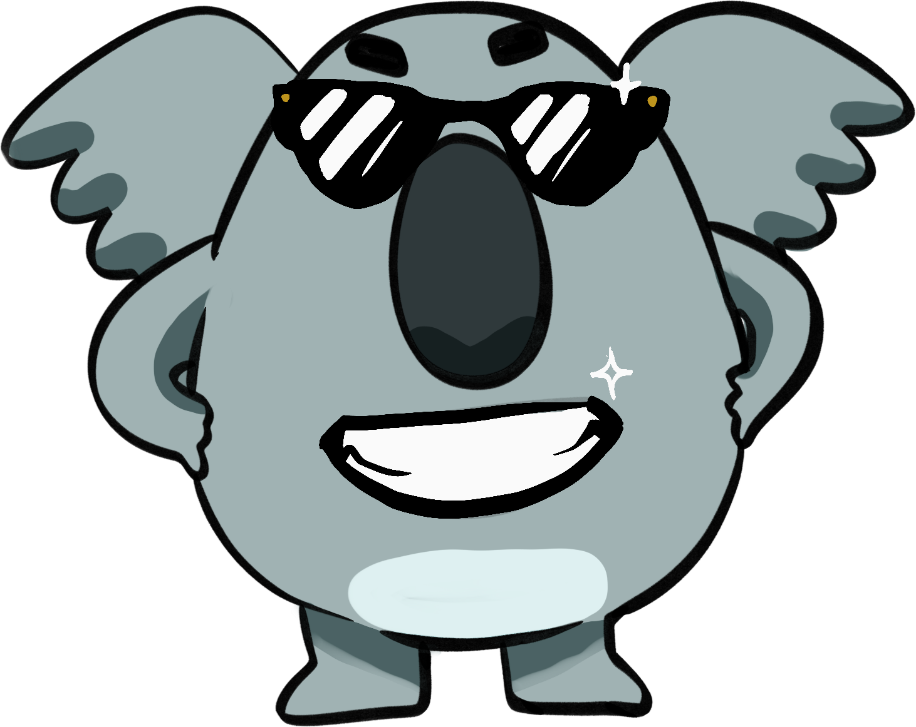
LEVEL 3

Slide 70
Let’s Go! 2
Rotating letters, progress resets to checkpoint if incorrect

Slide 71
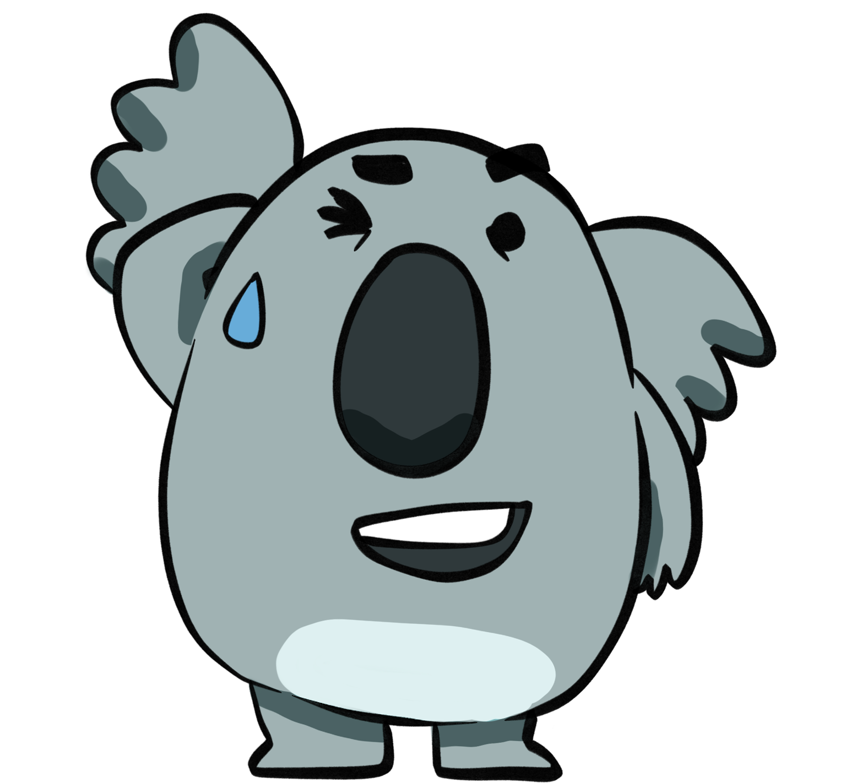
TRY AGAIN!

Slide 72
B
D
C
A

Slide 73
C
A
B
D

Slide 74
A
C
B
D

Slide 75
B
A
D
C

Slide 76
F
E
G

Slide 77
E
G
F

Slide 78
G
F
E

Slide 79
GOOD!

Slide 80
TRY AGAIN!

Slide 81
I
K
J
H

Slide 82
J
H
K
I

Slide 83
I
J
H
K

Slide 84
H
I
K
J

Slide 85
L
N
M

Slide 86
N
M
L

Slide 87
M
L
N

Slide 88
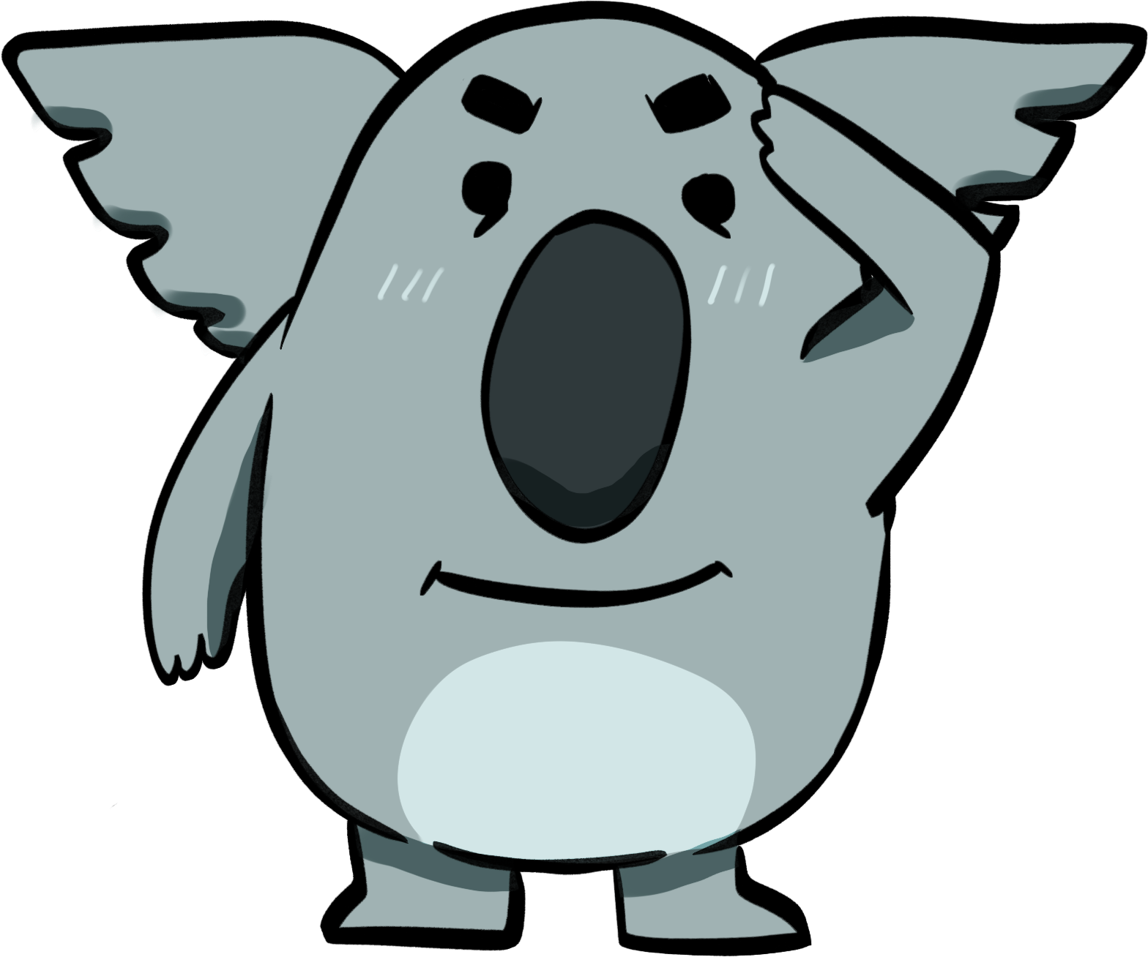
GOOD!

Slide 89
TRY AGAIN!

Slide 90
P
Q
O
R

Slide 91
O
P
Q
R

Slide 92
Q
O
R
P

Slide 93
P
R
Q
O

Slide 94
U
T
S

Slide 95
S
U
T

Slide 96
U
S
T

Slide 97
GOOD!

Slide 98
TRY AGAIN!

Slide 99
W
V

Slide 100
V
W

Slide 101
Z
X
Y

Slide 102
Y
X
Z

Slide 103
X
Y
Z

Slide 104
GOOD JOB!
FINISH!

Slide 105
TRY AGAIN

