Slide 1
Comparatives &
Superlatives

Slide 2
Demonstration

Slide 3
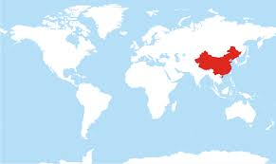
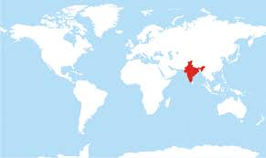
Which is bigger (by size)?
China
India

Slide 4
China is bigger than India
9.597km²
3.287km²

Slide 5
Rearrange the words
than, are, apples, bigger, watermelons
Watermelons are bigger than apples.

Slide 6
Bigger
______ is/are bigger than _______
Free answer!

Slide 7
Let’s start!

Slide 8
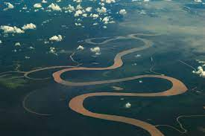
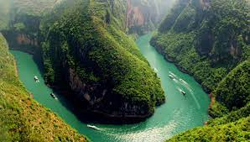
Which is longer?
The Amazon
The Yangtze

Slide 9
The Amazon is longer than the Yangtze
6400km
6300km

Slide 10
As exciting as
_______ is/are as exciting as _________
Free answer!

Slide 11
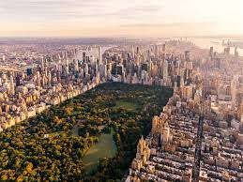
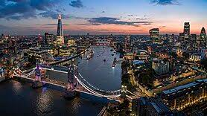
Which is bigger (by population)?
New York
London

Slide 12
London is bigger than New York
8.1 million
9.5 million

Slide 13
Rearrange the words
world, cheetah, the, the, in, are, land, fastest, animal
Cheetahs are the fastest land animals in the world.

Slide 14
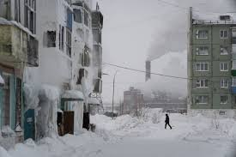
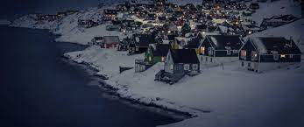
Which is colder?
Russia
Greenland

Slide 15
Greenland is colder than Russia
-67 °C
-69°C

Slide 16
Cute
_______ is/are cuter than _________
Free answer!

Slide 17
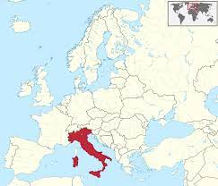
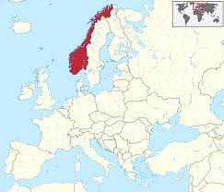
Which is smaller (by size)?
Italy
Norway

Slide 18
Italy is smaller than Norway
301,300km²
385,200km²

Slide 19
Rearrange the words
more, than, computers, notebooks, expensive, are
Computers are more expensive than notebooks.

Slide 20
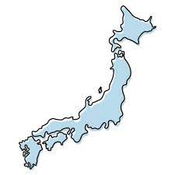
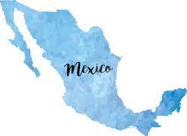
Which is bigger (by population)?
Japan
Mexico

Slide 21
Mexico is bigger than Japan
125.7 million
126.7 million

Slide 22
Fastest
_____ is/are the fastest ______ in/of ~
Free answer!

Slide 23
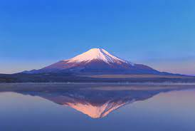
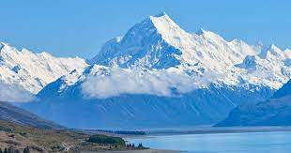
Which is taller?
Mt Fuji
Aoraki Mt Cook

Slide 24
Mt Fuji is taller than Aoraki Mt Cook
3776m
3724m

Slide 25
Rearrange the words
high, elementary, junior, Aojima, Aojima, school, school, than, is, bigger
Aojima Elementary School is bigger than Aojima Junior High School

Slide 26
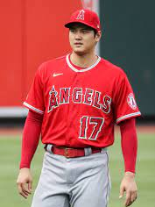
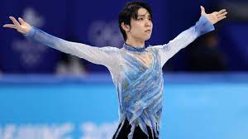
Who is older?
Shohei Ohtani
Yuzuru Hanyu

Slide 27
Shohei Ohtani is older than Yuzuru Hanyu
July 5 1994
December 7 1994

Slide 28
More beautiful
_________ is/are more beautiful than _________
Free answer!

Slide 29
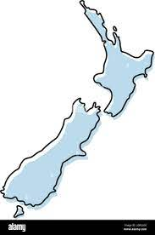
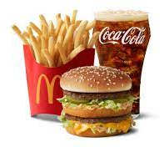
Which is more expensive?
A Big Mac set in New Zealand
A Big Mac set in Japan

Slide 30
A Big Mac set in New Zealand is more expensive than a Big Mac set in Japan
$15NZD = 1346 yen
750 yen

Slide 31
Rearrange the words
sport, is, in, world, most, soccer, popular, the, the
Soccer is the most popular sport in the world

Slide 32
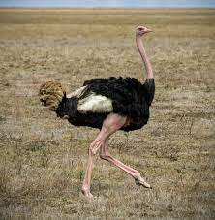
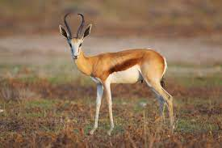
Which are faster?
Springboks
Ostriches

Slide 33
Ostriches are faster than springboks
88km/h
90km/h

Slide 34
Rearrange the words
class, class, English, Japanese, interesting, as, as, is
English class is as interesting as Japanese class.

Slide 35
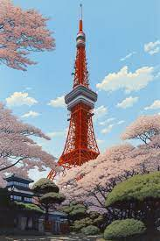
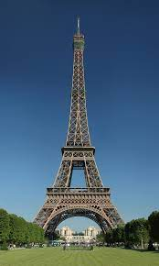
Which is taller?
Tokyo Tower
The Eiffel Tower

Slide 36
Tokyo Tower is taller than the Eiffel Tower
333m
324m

Slide 37
Most popular
_______ is/are the most popular ______ in/of ~
Free answer!

Slide 38
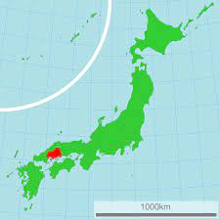
Which is smaller (by size)?
Hiroshima
Hyogo

Slide 39
Hyogo is smaller than Hiroshima
8480km²
8392km²

Slide 40
Rearrange the words
cats, elephants, heavier, are, than
Elephants are heavier than cats

Slide 41
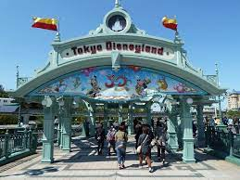
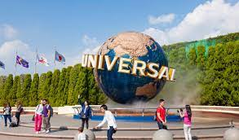
Which is bigger?
Tokyo Disneyland
USJ

Slide 42
USJ is bigger than Tokyo Disneyland
115 acres
133 acres

Slide 43
Which is bigger?
Tokyo DisneyLand
Tokyo DisneySea

Slide 44
Tokyo DisneySea is bigger than Tokyo Disneyland
115 acres
121 acres

Slide 45
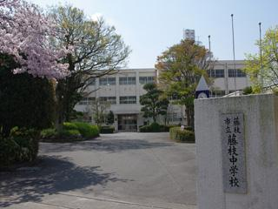
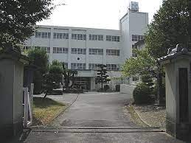
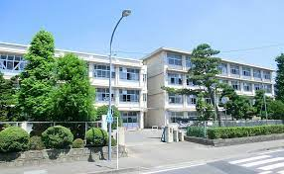
Which is bigger (by number of students)?
Fujieda JHS + Nishimashizu JHS together
Aojima JHS

Slide 46
Aojima JHS is bigger than Fujieda JHS and Nishimashizu JHS together
806
519+274=793

Slide 47
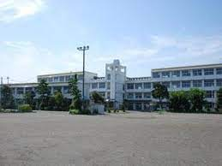
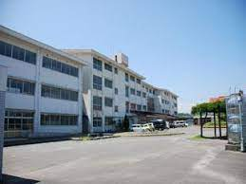
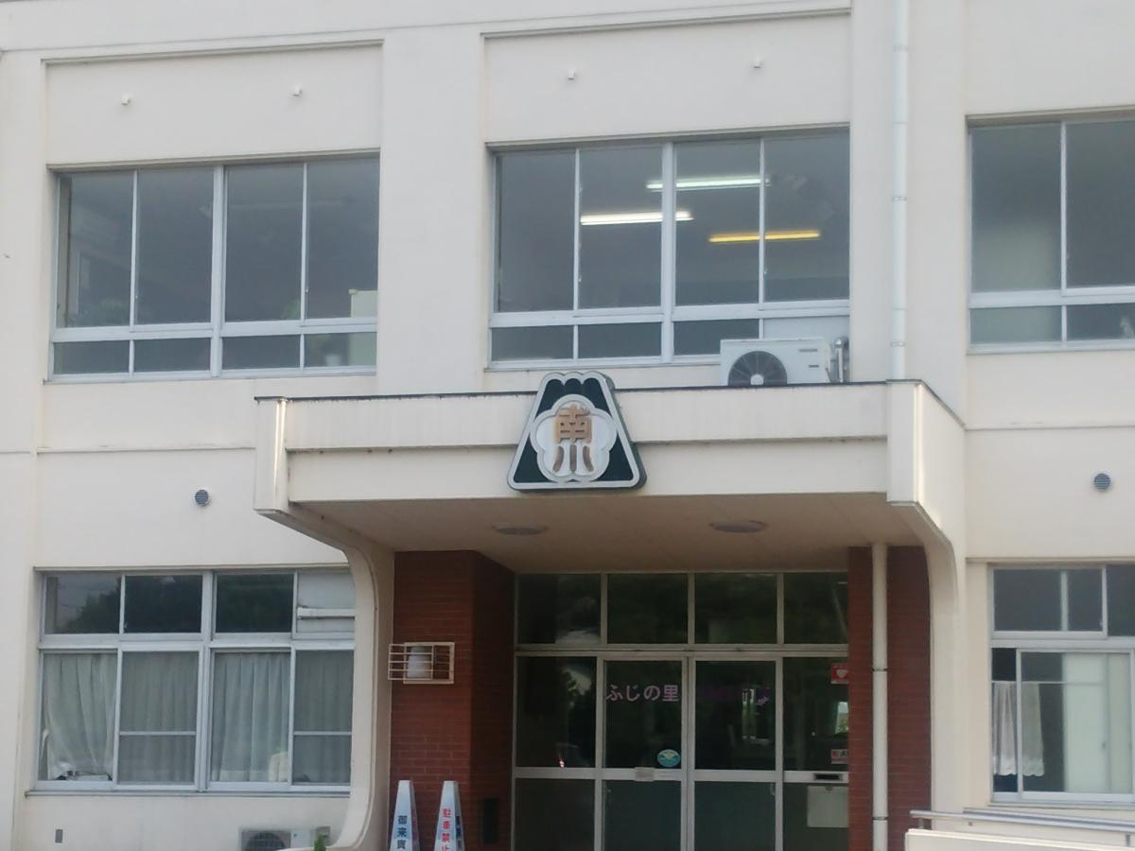
Which is bigger (by number of students)?
Aojimakita ES + Takasu Minami ES together
Aojima ES

Slide 48
Aojimakita ES and Takasu Minami ES together are bigger than Aojima ES
514+615=1129
999

Slide 49
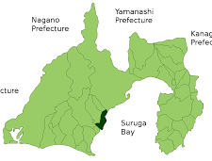
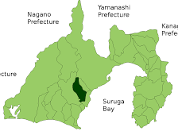
Which was bigger (by population in 2020)?
Yaizu
Fujieda

Slide 50
Fujieda was bigger than Yaizu
136,845
141,342

Slide 51
Finished!
Who is the winner?

Slide 52
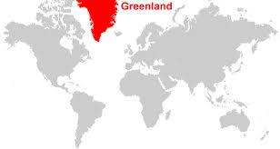
Greenland

