Slide 1
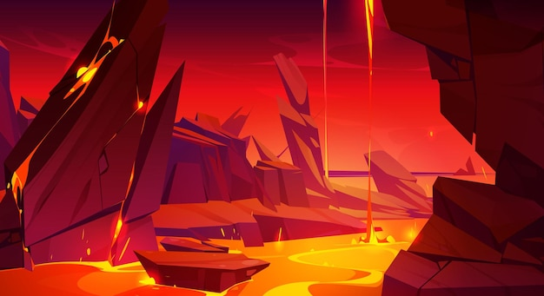
Lava Game

Slide 2
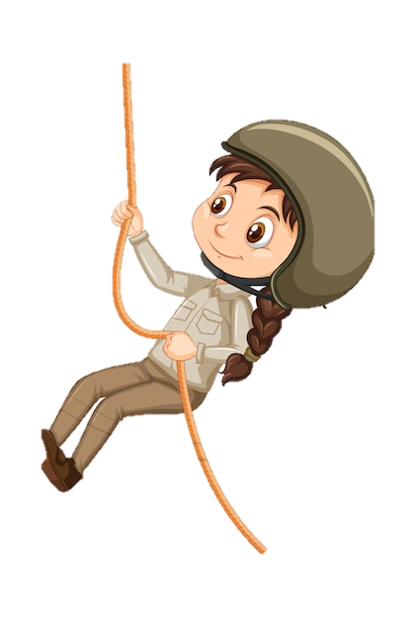
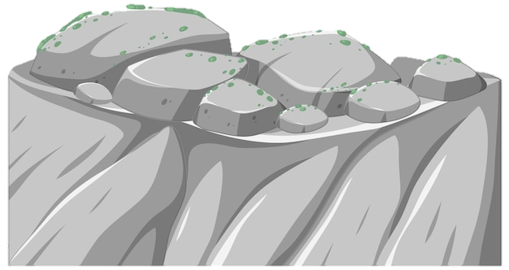
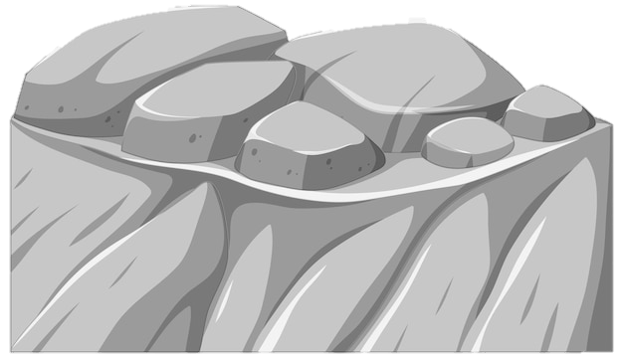
She OO play soccer.
do
does

Slide 3
I OO not eat shrimp.
Stage 2
does
do

Slide 4
The USSR was dissolved in 1991
Stage 3
True
False

Slide 5
Mt Everest is the tallest mountain in the world.
Stage 4
True
False

Slide 6
In Beauty and the Beast, Belle was the only one in her village to wear blue.
Stage 5
True
False

Slide 7
The different McNugget shapes have names.
Stage 6
True
False

Slide 8
Burger King’s ‘Whopper’ predates McDonald’s ‘Big Mac’
Stage 7
True
False

Slide 9
“May I have your attention, please” is the first line of Jay Z’s song, Slim Shady.
Stage 8
True
False

Slide 10
Nihondaira Zoo has giraffes.
Final Level
True
False

Slide 11
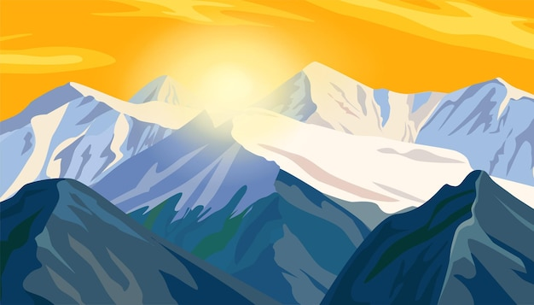
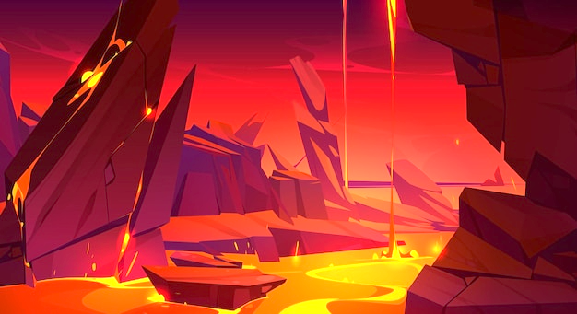
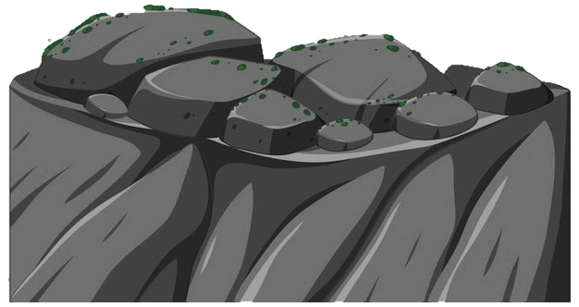
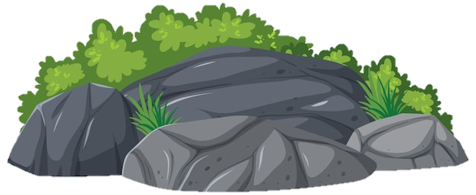
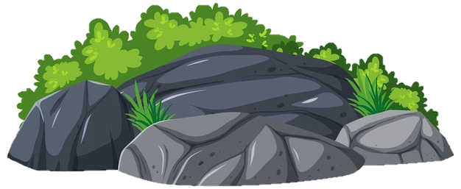
You did it!

Slide 12
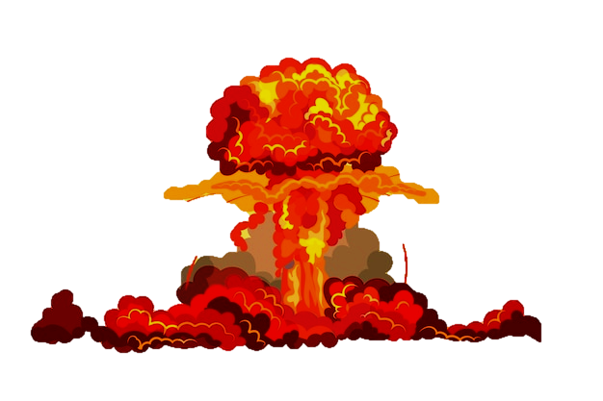
Unlucky!

