Slide 2
cute

Slide 3
cute

Slide 4
beautiful

Slide 5
beautiful

Slide 6
great

Slide 7
great

Slide 8
delicious

Slide 9
delicious

Slide 10
wonderful

Slide 11
wonderful

Slide 12
good

Slide 13
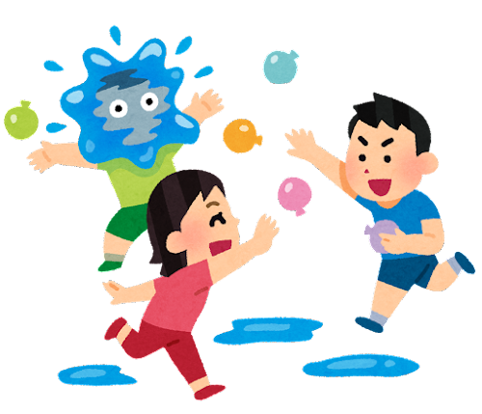
fun

Slide 14
spicy

