Slide 1
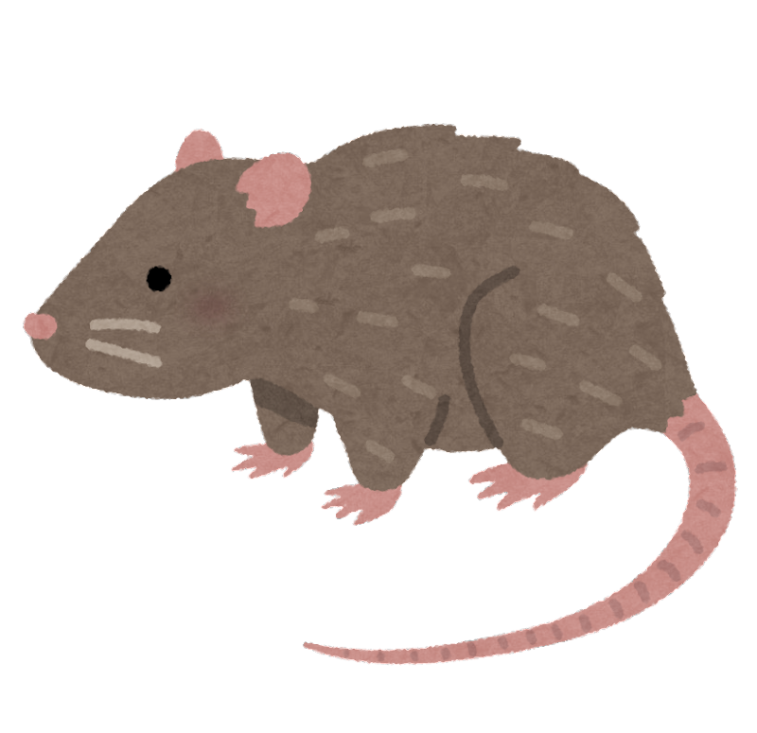
Protect
the Cheese

Slide 2
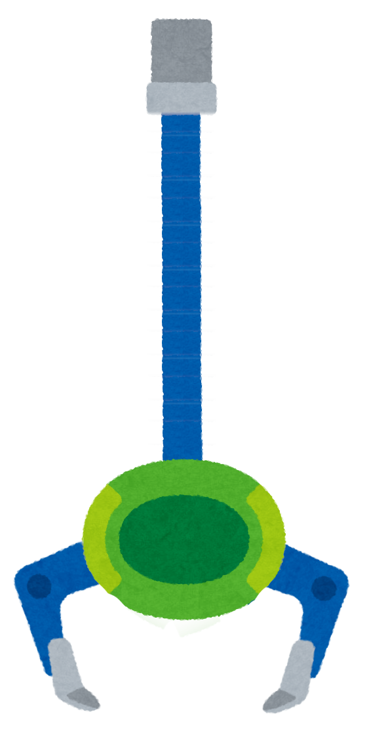
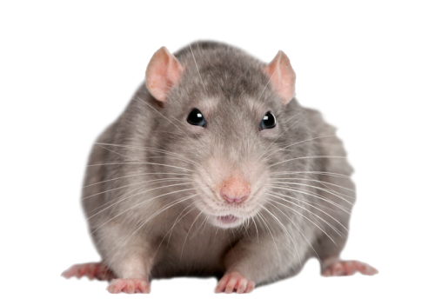
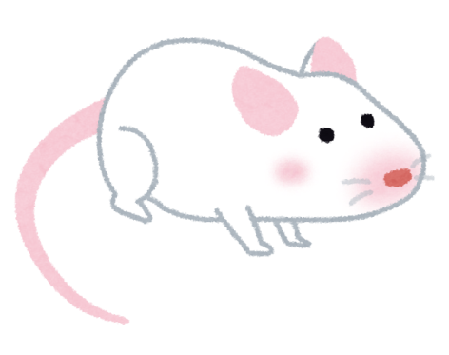
w
i
n
t
e
?
?
?
?
?
?
r
L
W
Click and drag to change the letters then place back in the original position. (Don’t delete the textbox)
PULL HERE

Slide 3
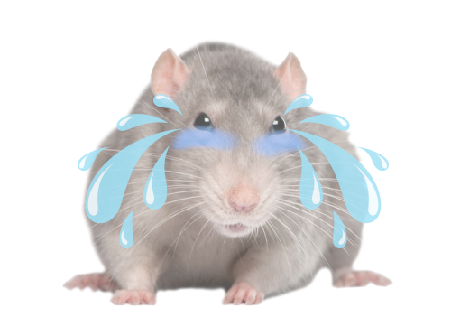
Well done!

Slide 4
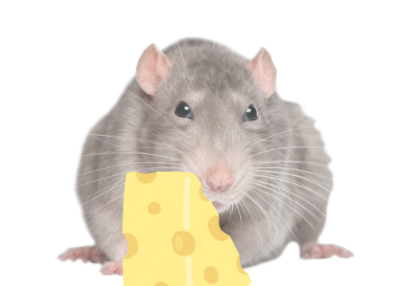
Nice try…

