Slide 1
Review
Extragavanza

Slide 2
Do you like pink?
Yes, I do. / No, I don’t.

Slide 3
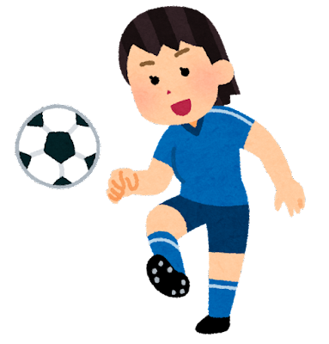
Can you play soccer?
Yes, I can. / No, I can’t.

Slide 4
Are you good at cooking?
Yes, I am. / No, I’m not.

Slide 5
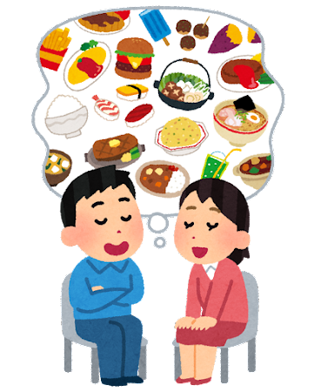
What food do you like?
I like (food).

