Slide 1
BONK Game – How to play
Everyone starts the game with 5 points.
For each round, students are given a choice of key words. Students repeat each word and then choose one. (use their name magnets or a set of mini cards on their desk)
When all students have made their selection count down from 3 and click to drop the bowling balls. Anyone who gets ‘bonked’ loses one point.
Each new round, students can change their choices. After the final round, check who survived with the most points.

Slide 2
GAME
BONK!

Slide 3
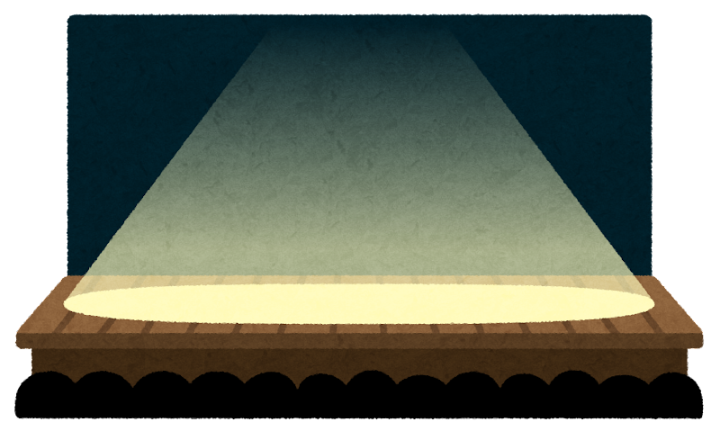
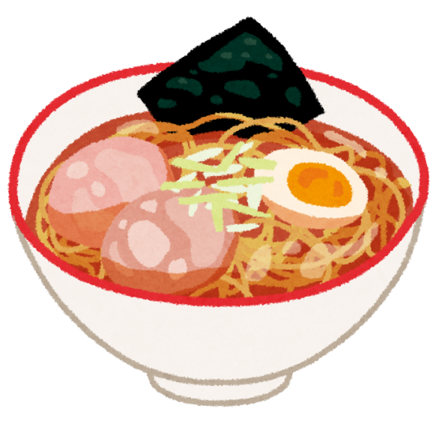
DEMONSTRATION!
I like~

Slide 4
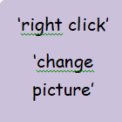
*target english*

Slide 5
*target english*

Slide 6
*target english*

Slide 7
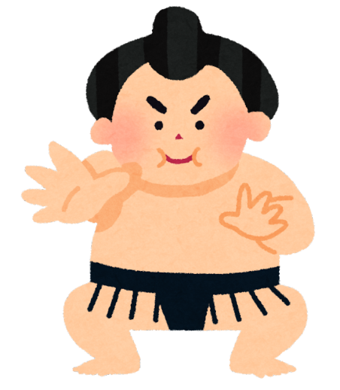
*target english*

Slide 8
Final!

Slide 9
FINISH!
WELL DONE!

