Slide 1
How to play
Students are in groups and each group is given either a sheet/flashcards with all the vocab or a set of number cards to correspond to the numbers in the game.
On each slide insert images corresponding to the target English.
ALT/HRT/JTE sets a timer and goes through the target English on the screen. When the timer has gone off, give STS some time to guess where they think the real image is. They guess by placing an ohajiki on the flashcard that corresponds to the space. After, click the next button to reveal where the real image is.
STS who guessed the correct place get 1 point!

Slide 2
Time Travel Game

Slide 3
Demonstration
3
1
2

Slide 4
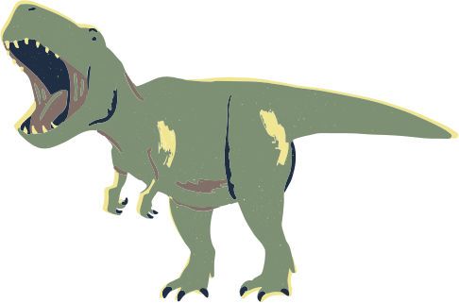
4
1
2
3

Slide 5
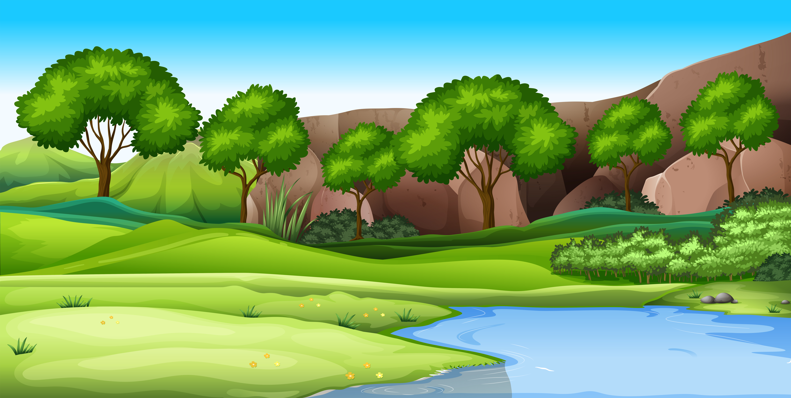
4
1
2
3

Slide 6
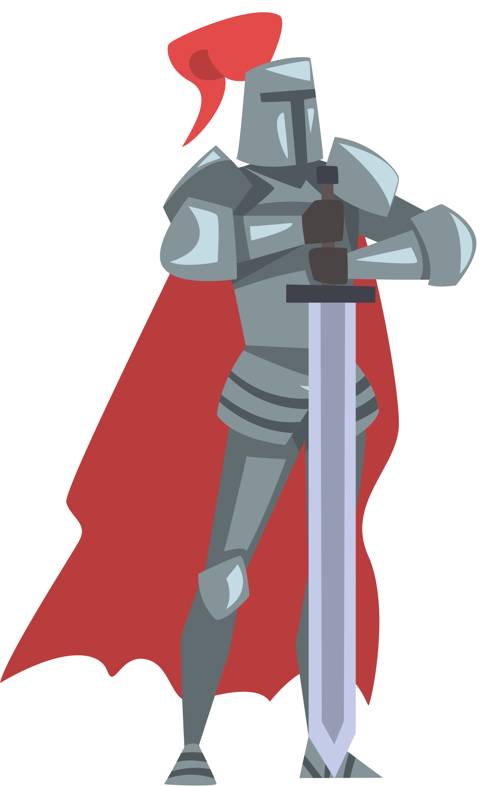
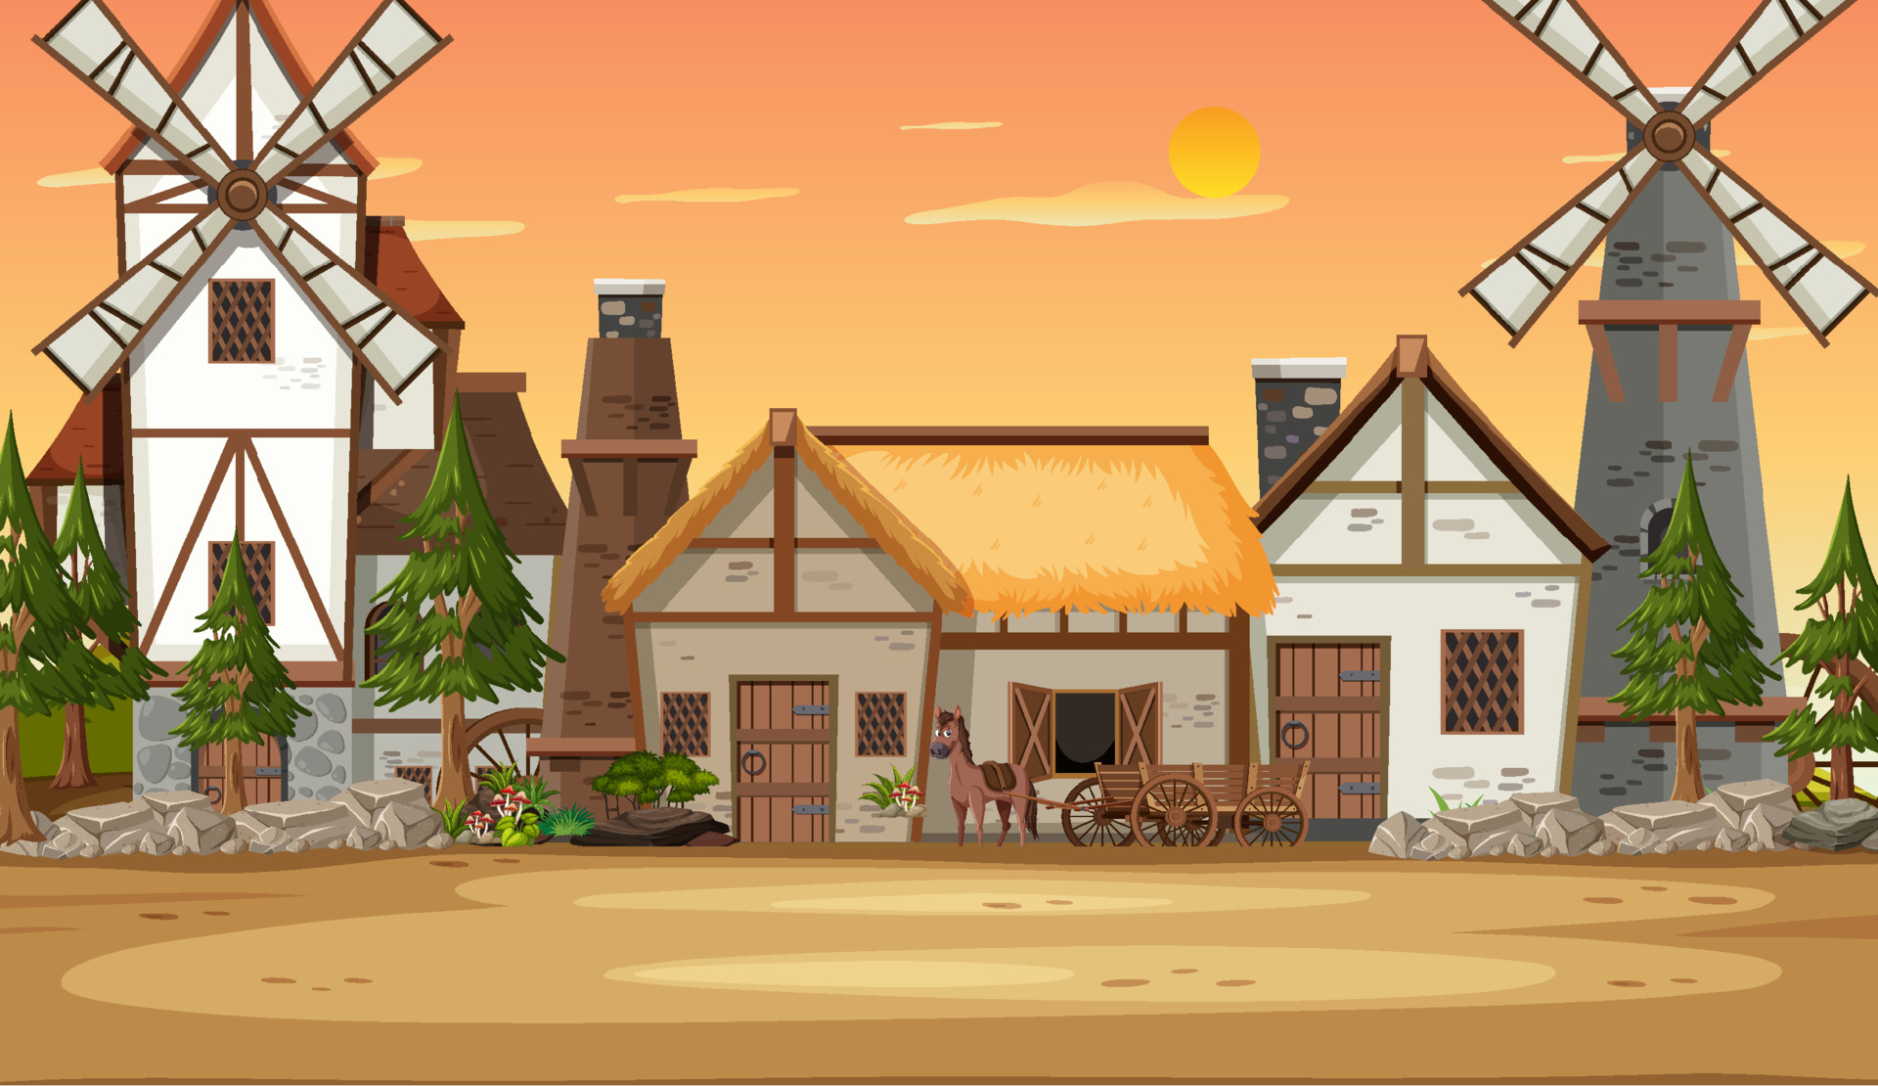
4
1
2
3

Slide 7
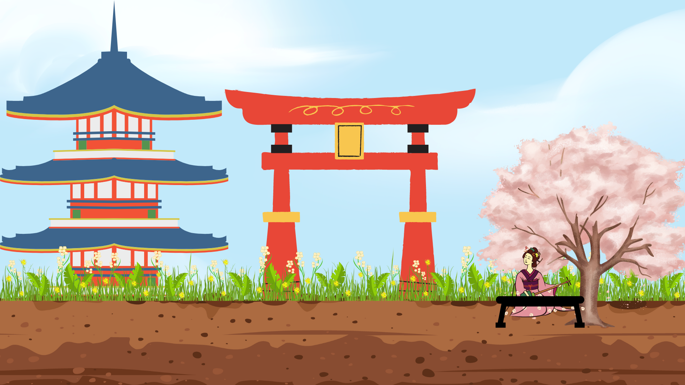
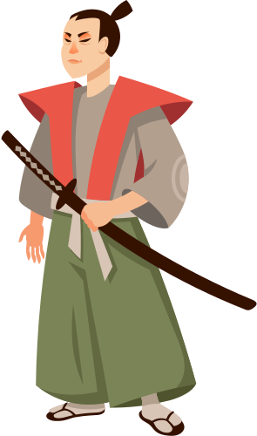
4
1
2
3

Slide 8
4
1
2
3

Slide 9
3
2
1
4

Slide 10
4
1
2
3

Slide 11
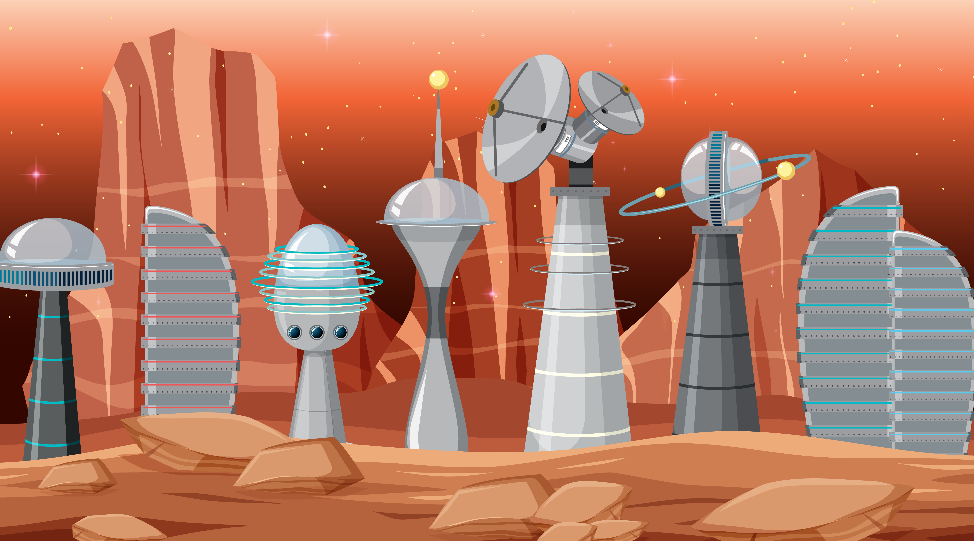
4
1
3
2

