Slide 4
X2 attack!
+3 to roll
2 Rolls!

Slide 5
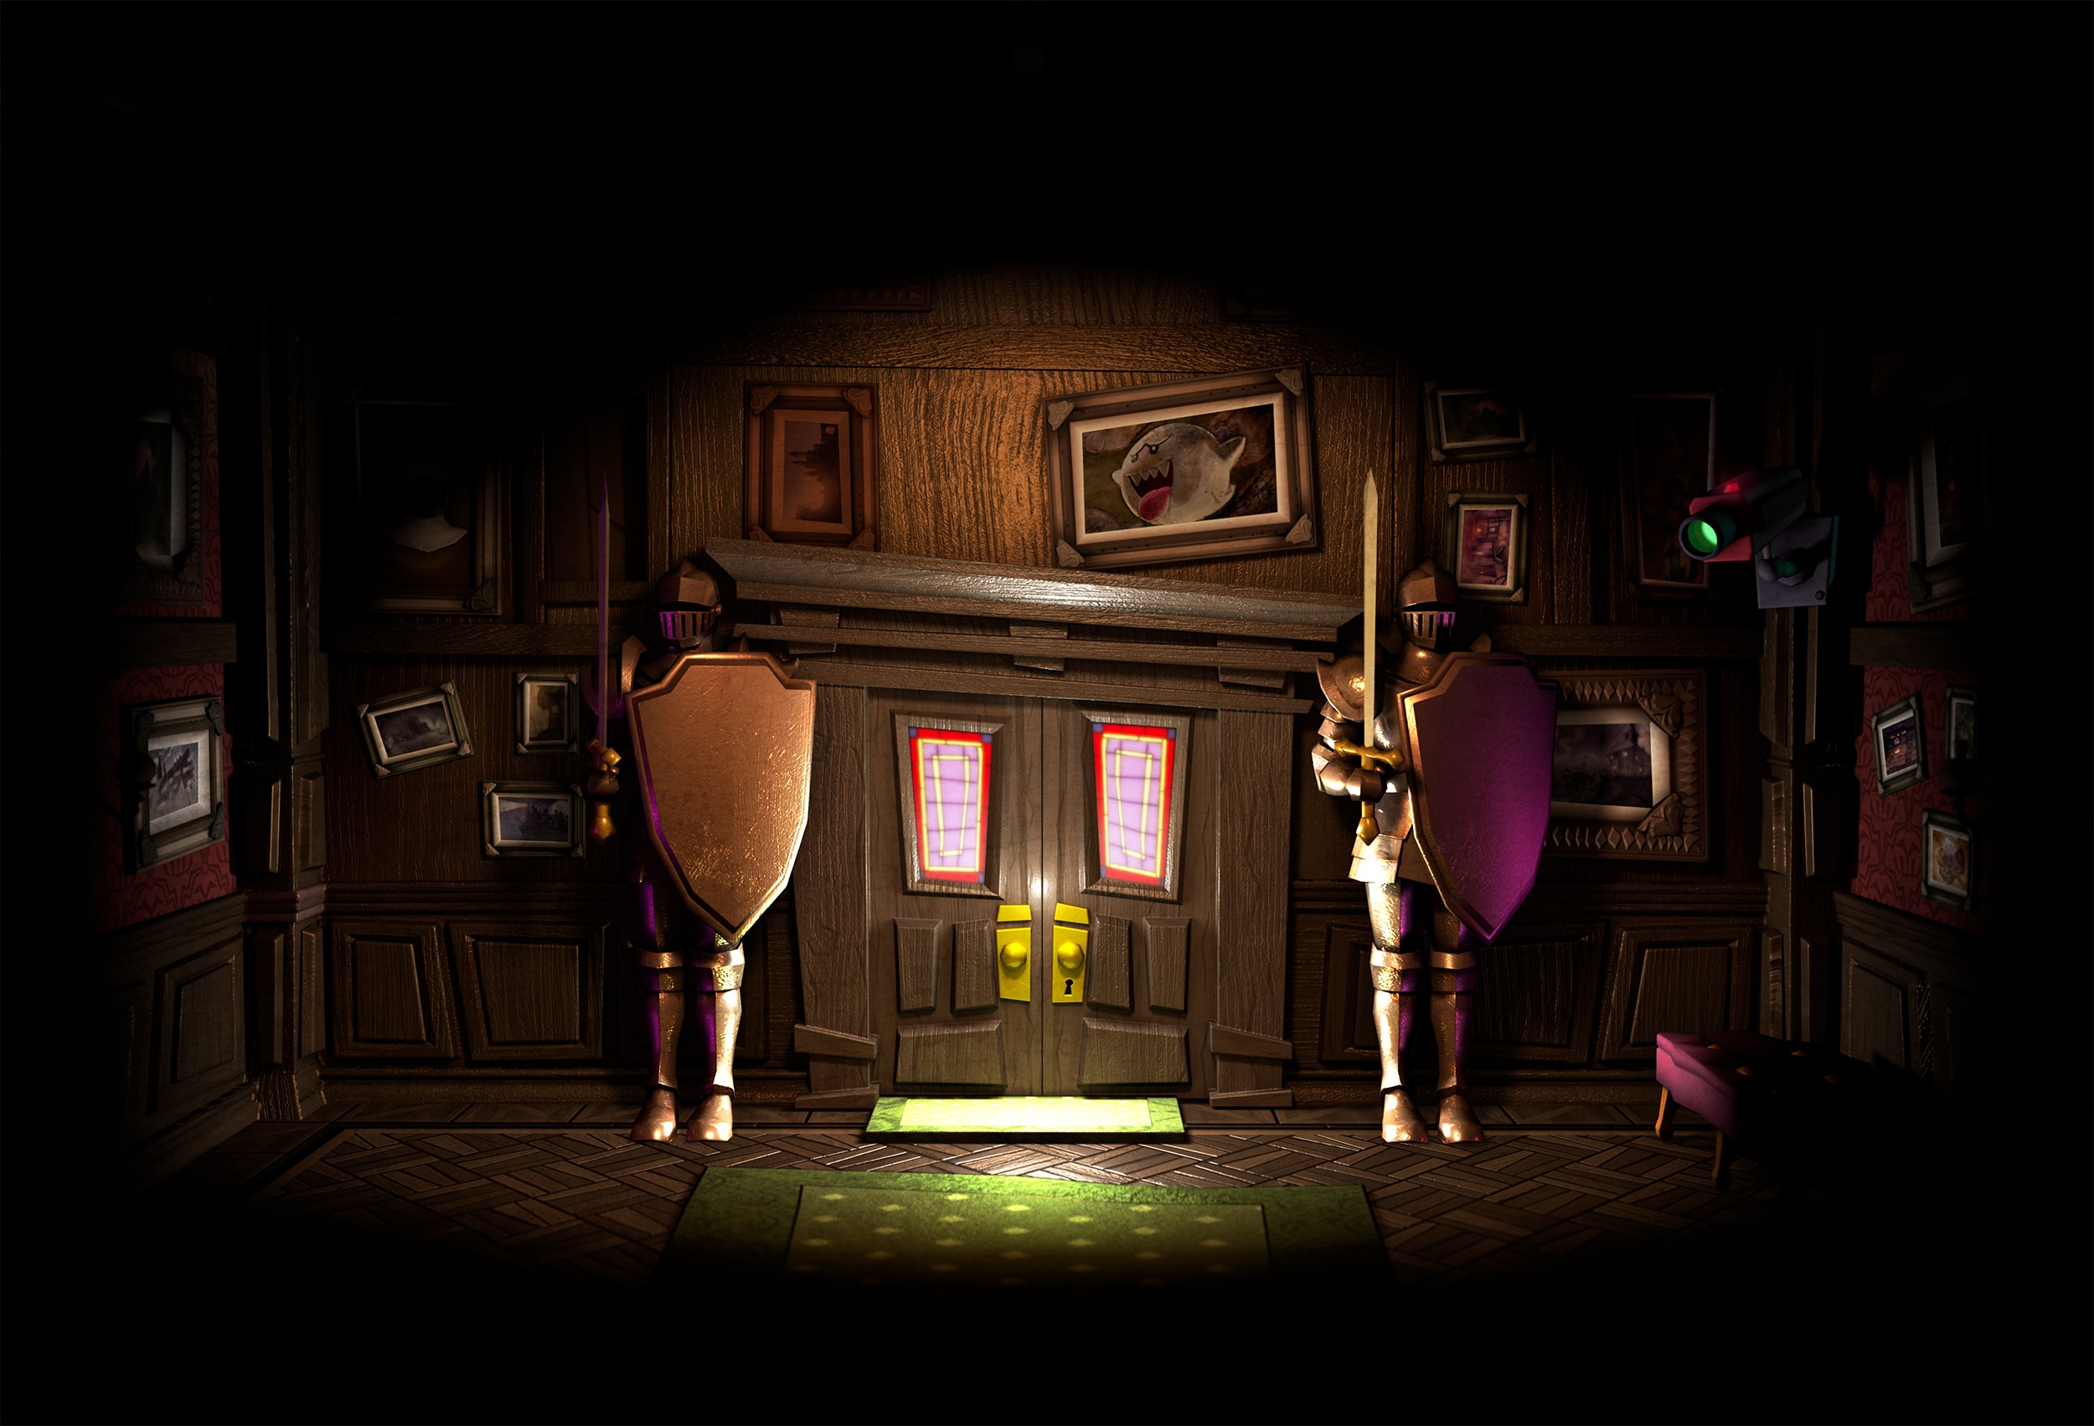

Slide 8
X2 Attack!
+3 to roll
2 Rolls!

Slide 13
