Slide 1
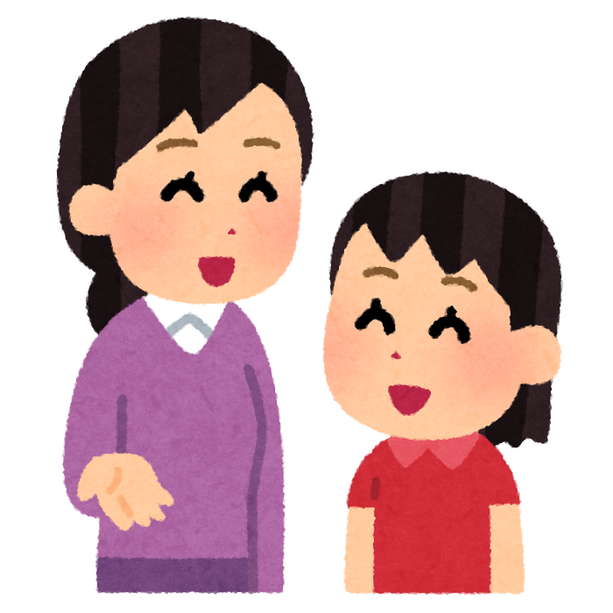
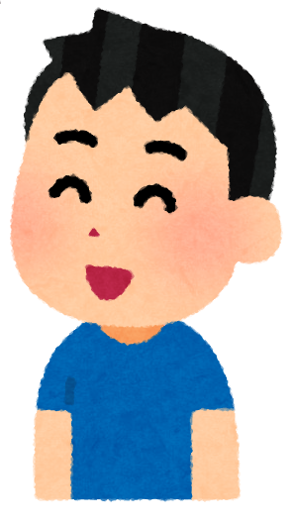
SMALL
TALK
WHEEL

Slide 2
SMALL TALK TIME!
What food do you like?
What sport do you like?
Where do you want to go?
What do you want for your b-day?
What sport do you NOT like?
What character do you like?
What are you good at?
What time do you wake up?
What snack do you like?
What did you eat for breakfast?
What did you eat for dinner?
What time do you go to bed?
What color do you NOT like?
What subject do you like?
Click the arrow to spin/stop!
What food do you NOT like?
What pet do you want?
What animal do you like?
When is your birthday?
What kyushoku do you like?
What drink do you like?
What restaurant do you like?
What ice cream do you like?
What season do you like?
What can you cook?
Click the piece to see the topic!

Slide 3


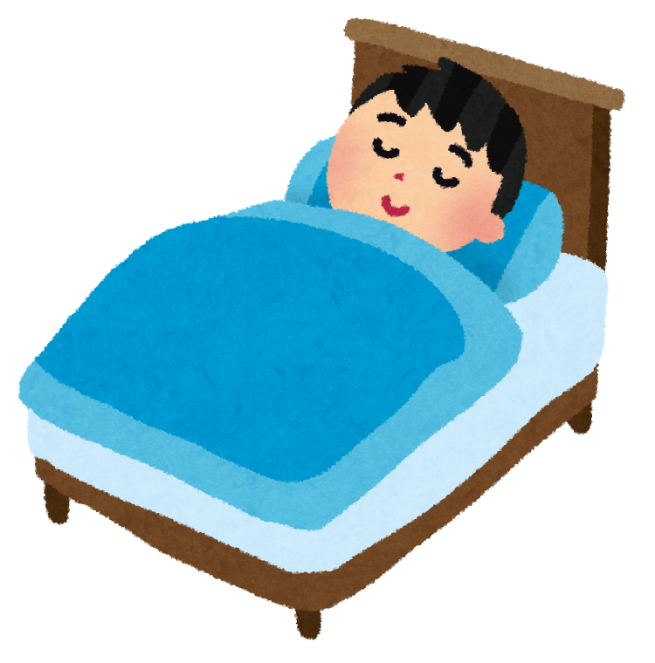
RETURN
[Q]
I go to bed at OOO!
What time do you go to bed?
?

Slide 4
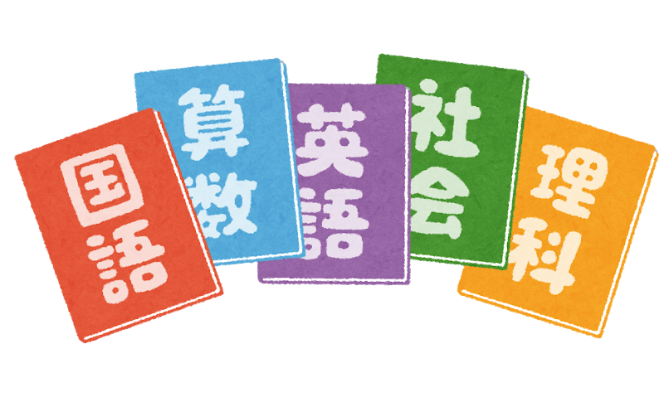
RETURN
[Q]
I like OOO!
What subject do you like?

Slide 5

RETURN
[Q]
I want a OOO!
What pet do you want?

Slide 6
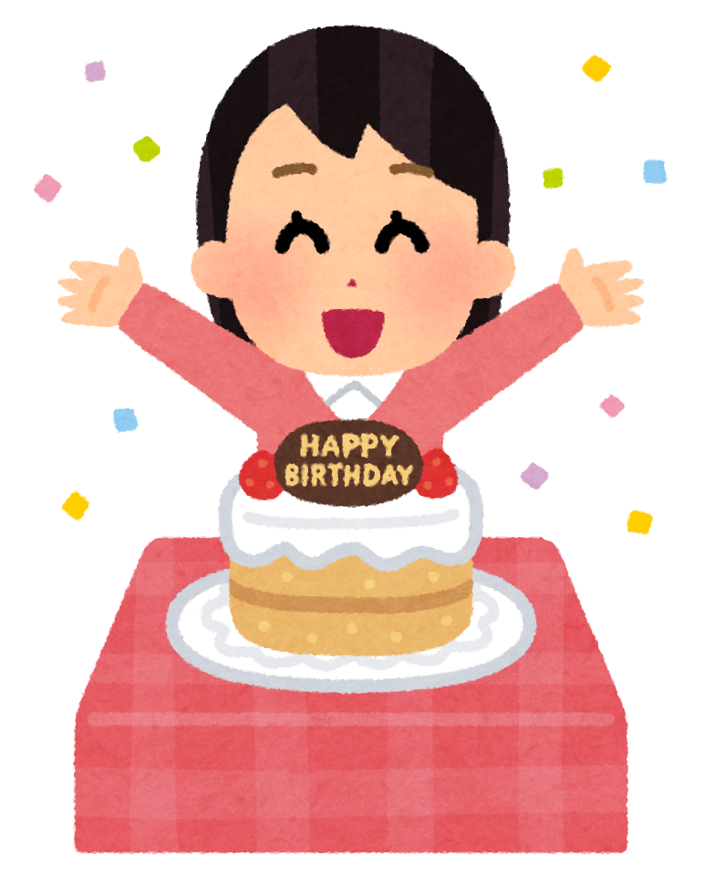
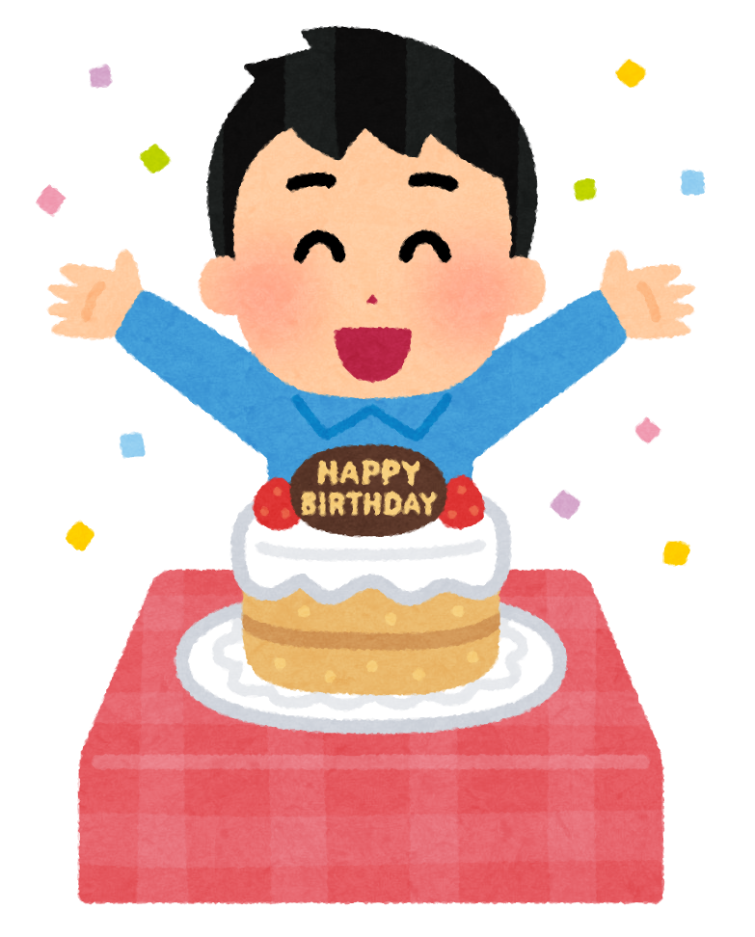
RETURN
[Q]
My birthday is OOO!
When is your birthday?

Slide 7
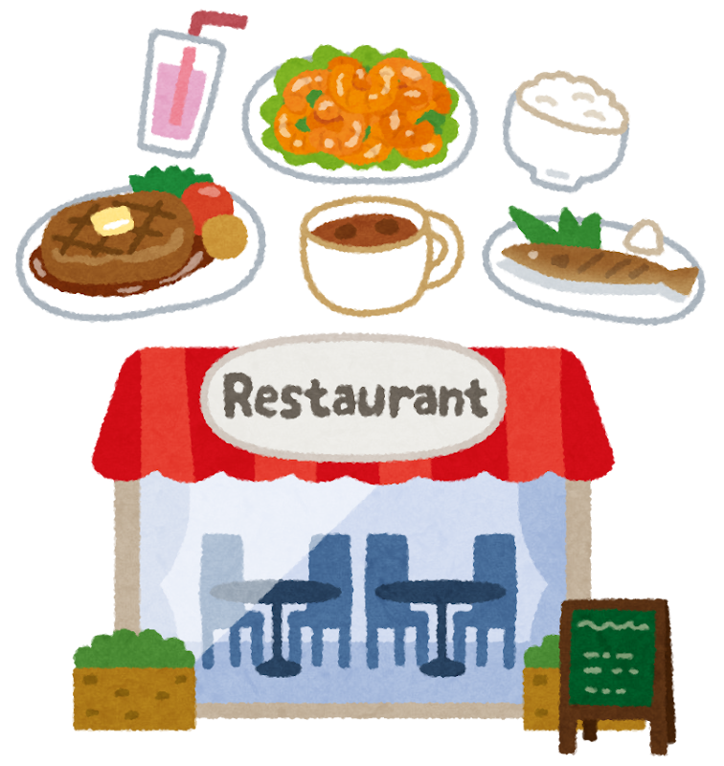
RETURN
[Q]
I like OOO!
What restaurant do you like?

Slide 8
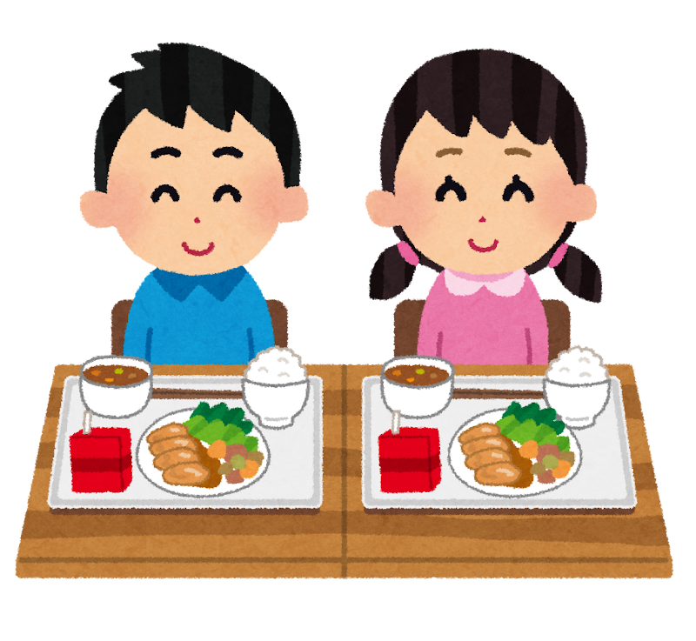
RETURN
[Q]
I like OOO!
What kyushoku do you like?

Slide 9




RETURN
[Q]
I like OOO!
What season do you like?

Slide 10
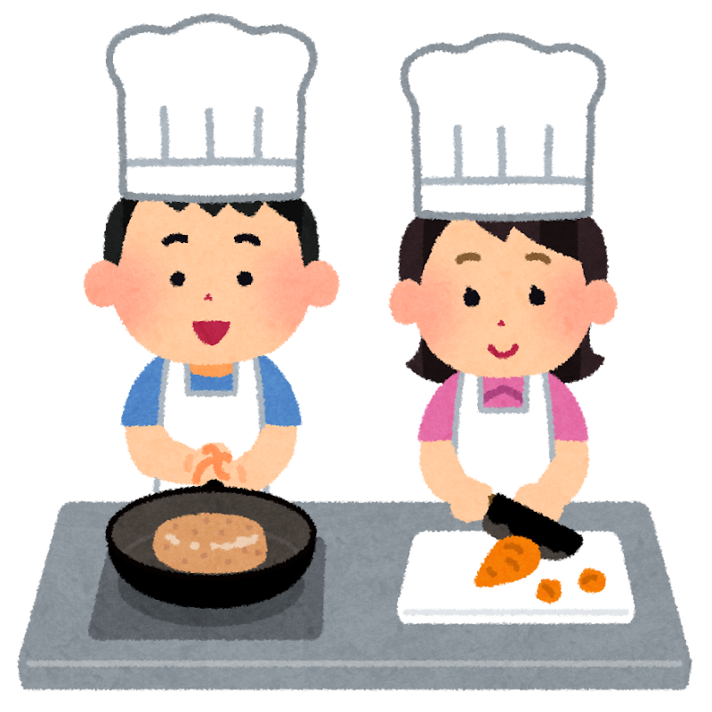
RETURN
[Q]
I can cook OOO!
What food can you cook?

Slide 11
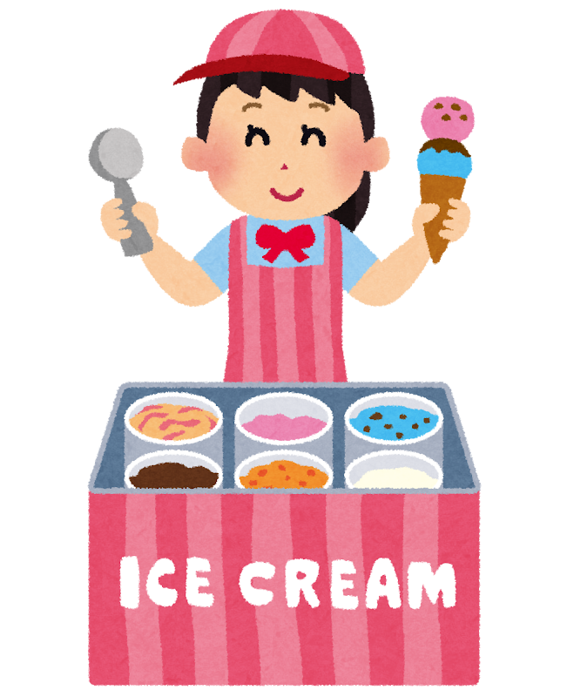
RETURN
[Q]
I like OOO!
What ice-cream do you like?

Slide 12
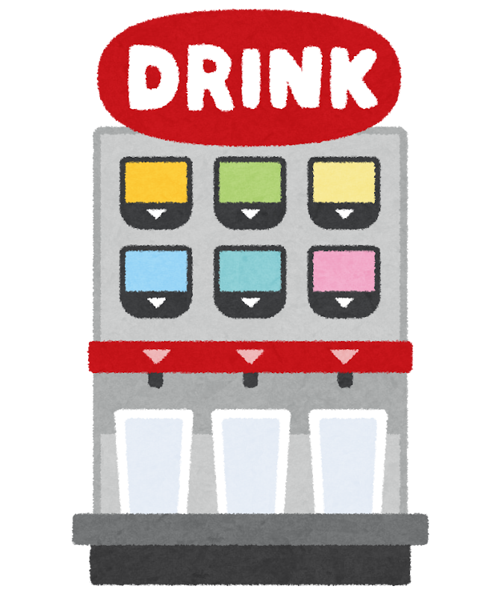
RETURN
[Q]
I like OOO!
What drink do you like?

Slide 13
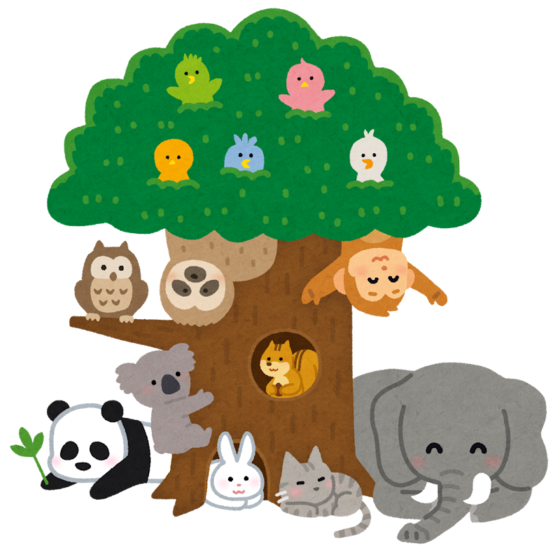
RETURN
[Q]
I like OOO!
What animal do you like?

Slide 14
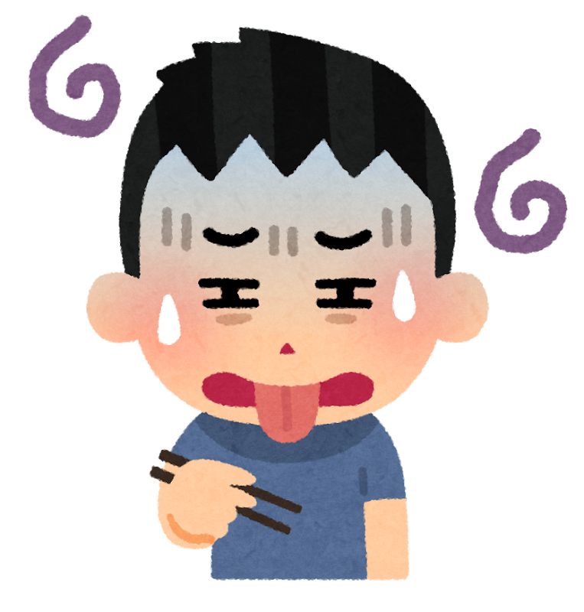
RETURN
[Q]
I don’t like OOO!
What food do you NOT like?

Slide 15
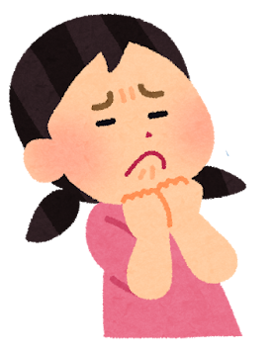

RETURN
[Q]
I don’t like OOO!
What color do you NOT like?

Slide 16
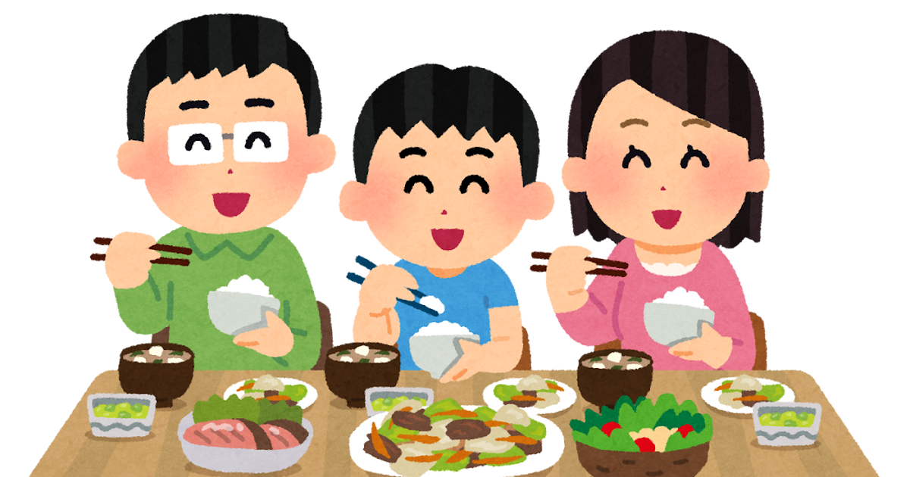
RETURN
[Q]
I ate OOO!
What did you eat for dinner?

Slide 17
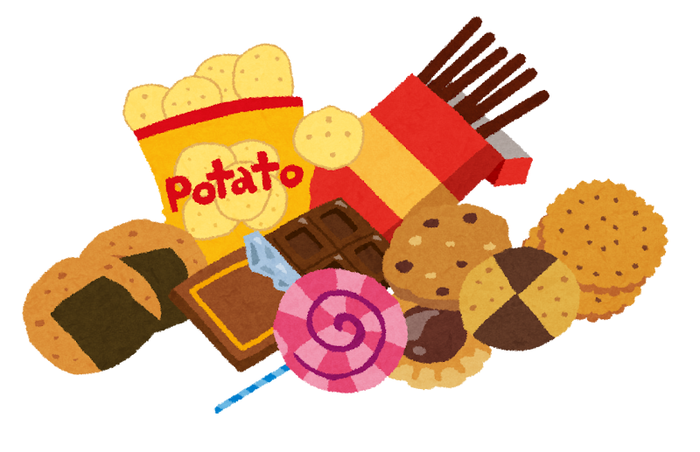
RETURN
[Q]
I like OOO!
What snacks do you like?

Slide 18
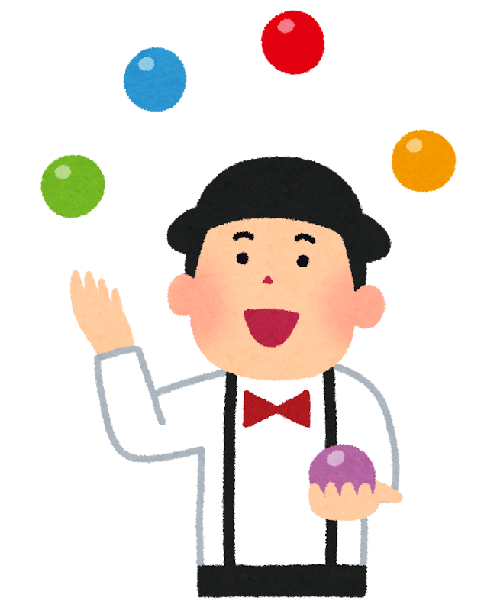
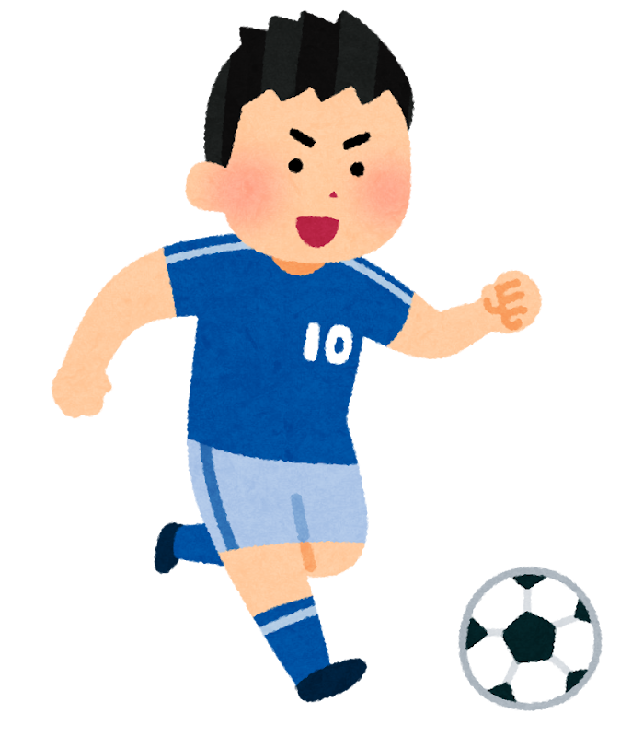

RETURN
[Q]
I’m good at OOO!
What are you good at?

Slide 19

RETURN
[Q]
I don’t like OOO!
What sport do you NOT like?

Slide 20


RETURN
[Q]
I want a OOO!
What do you want for your birthday?

Slide 21

RETURN
[Q]
I like OOO!
What food do you like?

Slide 22
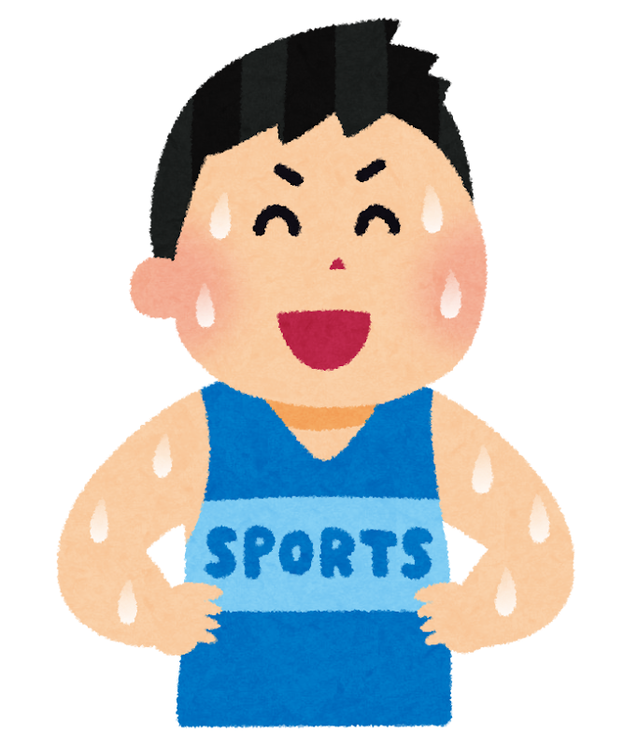
RETURN
[Q]
I like OOO!
What sport do you like?

Slide 23


RETURN
[Q]
I want to go to OOO!
Where do you want to go?

Slide 24
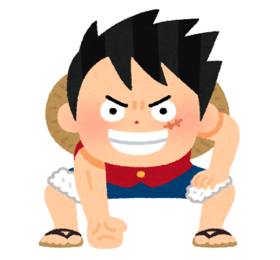
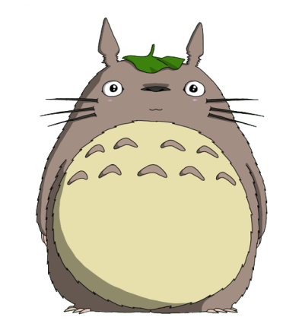

RETURN
[Q]
I like OOO!
What character do you like?

Slide 25
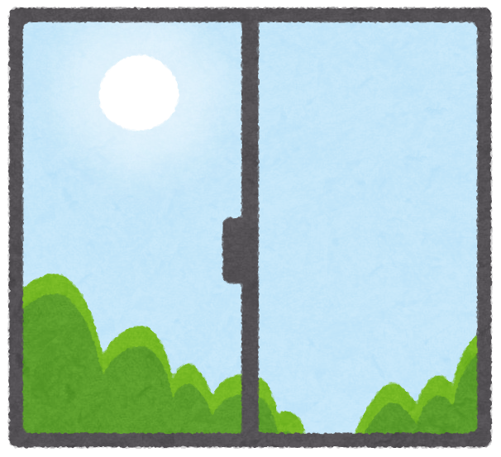
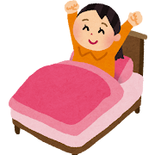
RETURN
[Q]
I get up at OOO!
What time do you get up?
?

Slide 26
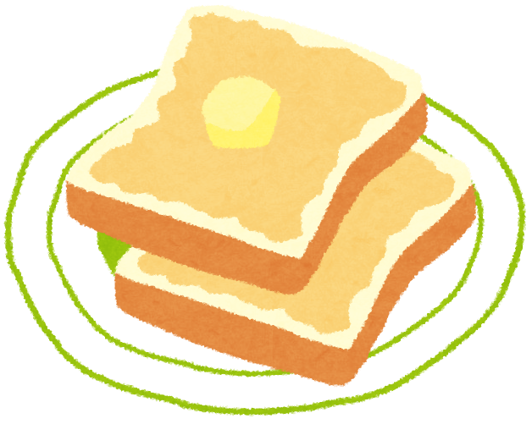
RETURN
[Q]
I ate OOO!
What did you eat for breakfast?

